Slide 1
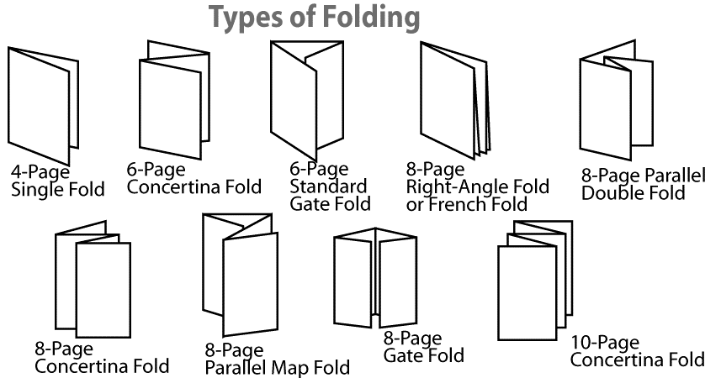
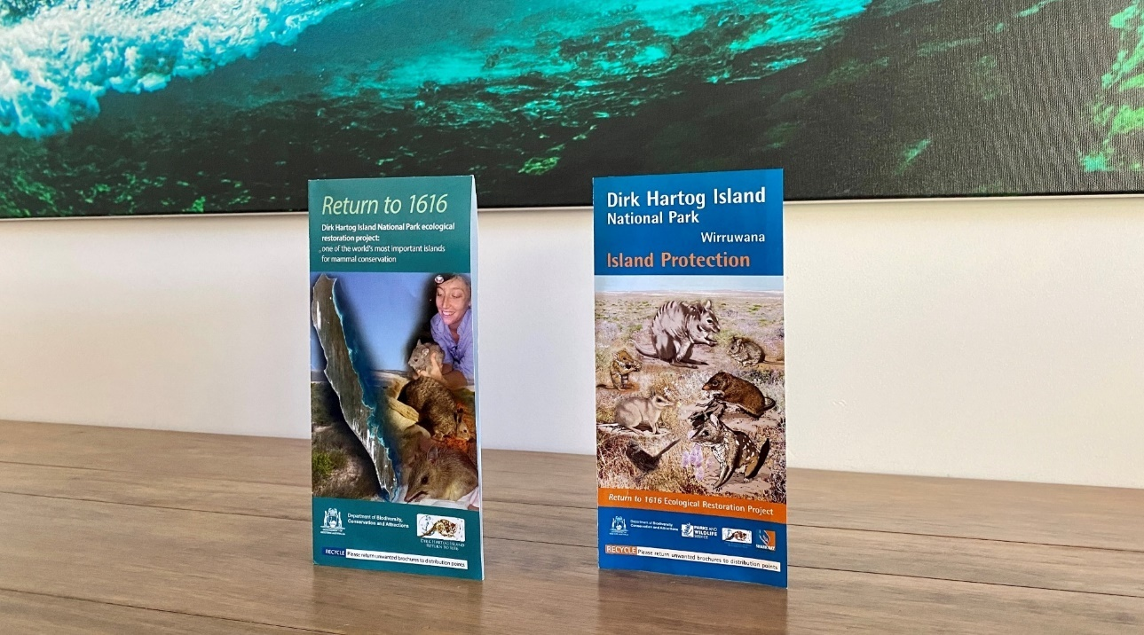
Return to 1616 Biodiversity Brochure
Dirk Hartog Island National Park Return to 1616 Ecological Restoration Project
Western Australia’s biodiversity is threatened. Would you like to do something to help? Create an information brochure that informs people about the biodiversity of Dirk Hartog Island and the importance of the Return to 1616 project.
Useful sites for information:
https://parks.dpaw.wa.gov.au/park/dirk-hartog-island
https://www.sharkbay.org/restoration/dirk-hartog-island-return-1616/
Tips for designing an effective brochure:
Create a colourful and eye-catching cover for your brochure.
Organise your information so it flows logically and present your ideas clearly.
Group similar types of ideas together so the reader knows exactly what each section discusses.
Answer the 5 Ws: Who? What? Where? When? Why?
Your brochure shouldn't contain so much information that it overwhelms the reader.
Make your brochure as attractive, appealing, and informative as you can.
Balance text with illustrations and use plenty of colour.
Use descriptive and precise writing.
Edit text for grammar, punctuation, spelling, and capitalization.
Decide on what type of folding the brochure will feature.
Consider using software like Microsoft Word or Publisher, Apple Pages or via online applications like Canva, MyCreativeShop, or Printing Press.
https://templates.office.com/en-au/travel-brochure-tm33746274
https://www.canva.com/create/brochures/

