Slide 1
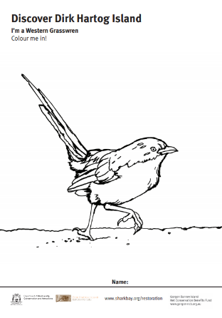
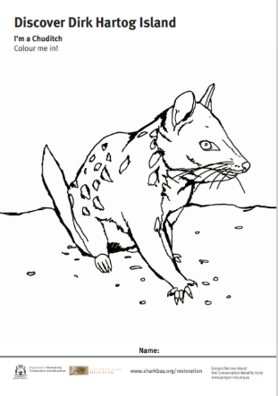
Return to 1616 Colouring Activities
Dirk Hartog Island National Park Return to 1616 Ecological Restoration Project
Have fun while you learn about the animals being returned to Dirk Hartog Island National Park. Colour in the animals being translocated to the island including the rufous hare-wallaby, banded hare-wallaby, dibbler and Shark Bay bandicoot, boodie, greater stick-nest rat, brush-tailed mulgara, Shark Bay mouse, western grasswren, woylie and finally, chuditch. Can you also draw and colour the correct habitat and food eaten by each of these animals?
Download colouring activities and fact sheets for each of the Return to 1616 animals at:
https://www.sharkbay.org/restoration/dirk-hartog-island-return-1616/

