Slide 1
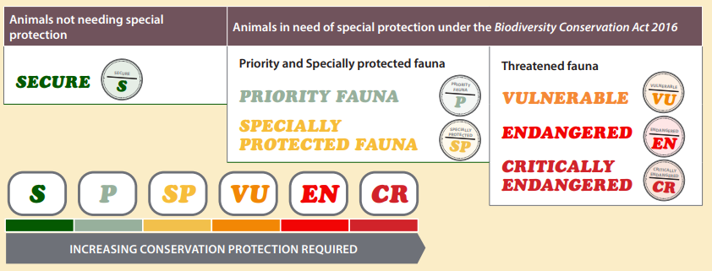
Return to 1616 Conservation Codes and Threatened Species
Dirk Hartog Island National Park Return to 1616 Ecological Restoration Project
Scientific surveys are used to estimate populations of plant and animal species. These codes are used to represent the status of populations.
The Department of Biodiversity, Conservation and Attractions maintains the following listings:
threatened native plants (flora)
threatened animals (fauna)
threatened ecological communities
Protection is needed for critically endangered, endangered or vulnerable species and ecological communities because they are under identifiable threat of extinction (species) or collapse (ecological communities). Research these lists for Western Australia and reflect on your thoughts below.
What did I LEARN?
What makes me CONCERNED?
What do I want to DO?

