Slide 1
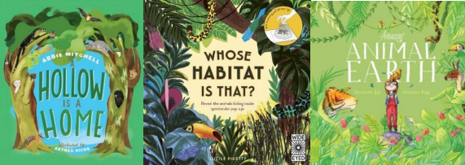
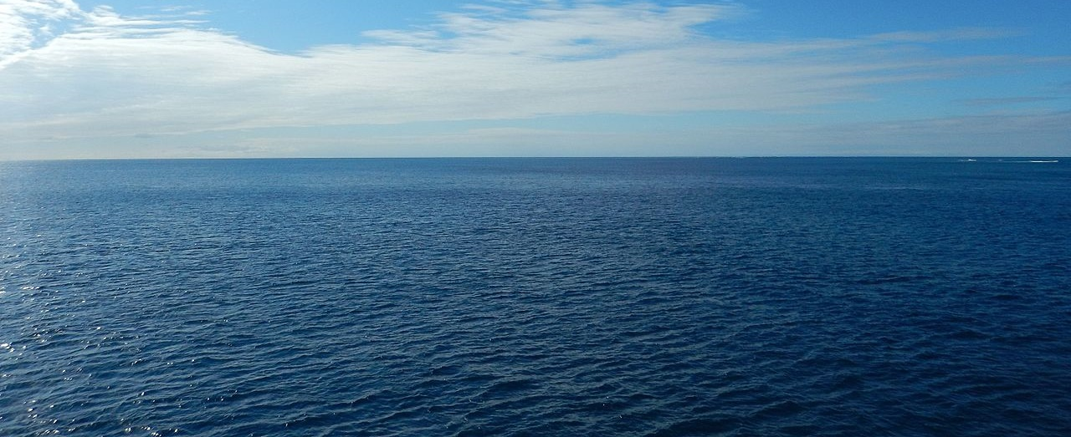
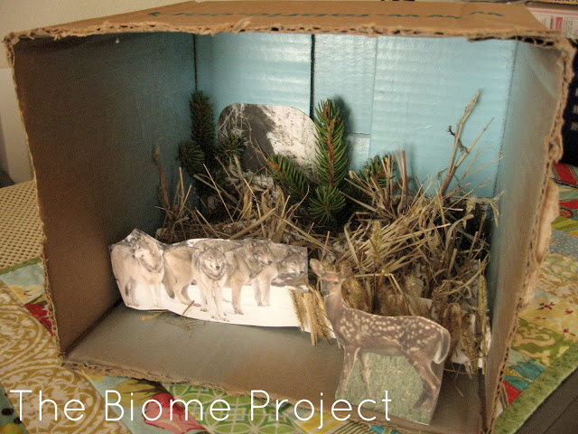
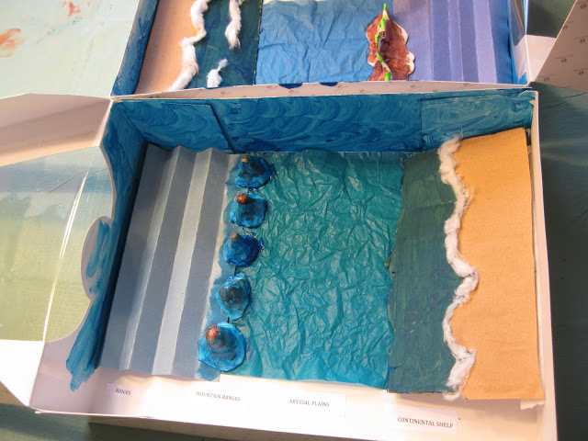
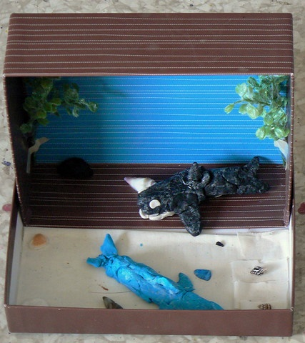
Return to 1616 Habitat Diorama
Dirk Hartog Island National Park Return to 1616 Ecological Restoration Project
What is a habitat? What makes up a habitat? What would happen if habitats changed? What do the Return to 1616 animals need? Do they all need the same habitat? What are some of the specific requirements?
Refer to the Return to 1616 animal factsheets, conduct some internet research or read a good book about animal habitats to develop your understanding. Some good books include:
A Hollow is a Home - Abbie Mitchell, Astred Hicks
Whose Habitat is That? - Lucile Piketty
Amazing Animal Earth - Alessandra Yapp.
Prepare a blueprint or rough sketch of your diorama design before you begin construction.
Suggested materials:
Shoebox or tissue box
Different types of paper
Air-dry clay
Random items: pipe cleaners, popsicle sticks,
tissue paper, buttons, scrap fabric, beads, seeds,
nuts, leaves, etc.
Magazines
Glue
Markers.
Gather pictures of the habitat and the animal to use for inspiration. Start making the plants and animals you would like to showcase in the habitat. You can use clay, cut them out, draw them on paper or use papier mache. Create the background for the habitat diorama and finally, use the shoebox to complete the habitat. Put the background in the back and place the animals and plants you have created towards the front.
Challenge: Choose one of the Return to 1616 animals and create a diorama to replicate their ideal habitat.

