Slide 1
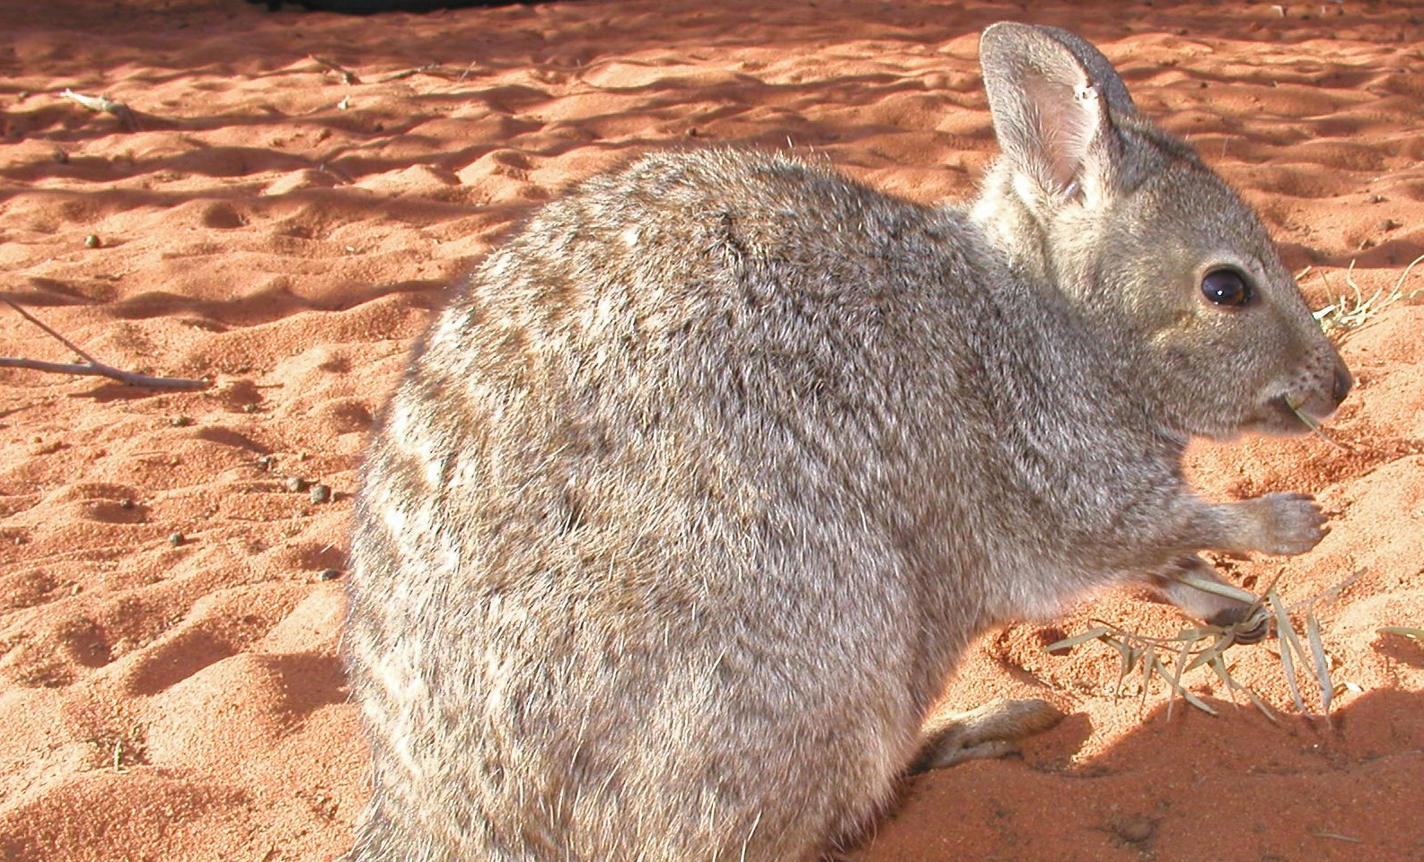
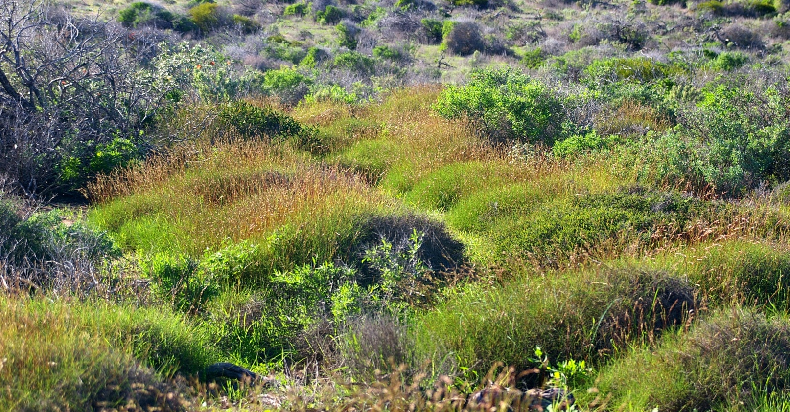
Inquiry Project Real-World Action
Dirk Hartog Island National Park Return to 1616 Ecological Restoration Project
This project challenges you to take real-world action! Are there issues affecting biodiversity in the Shark Bay region that you feel strongly about? Would you like to make a positive difference? Would you prefer to be part of the problem or part of the solution? Would you like to help to solve problems that matter to you?

Slide 2
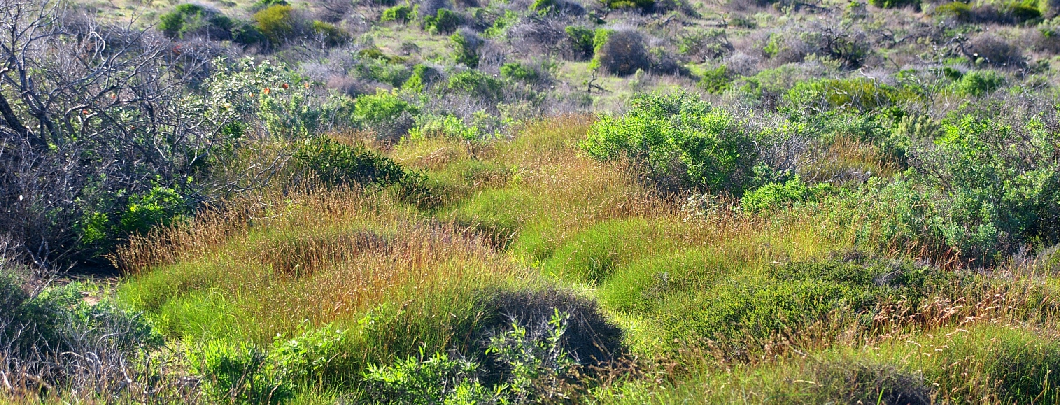
Return to 1616
Real-World Action Project
Dirk Hartog Island National Park Return to 1616 Ecological Restoration Project
Your challenge, should you choose to accept…
This project challenges you to take real-world action! Are there issues affecting biodiversity at Dirk Hartog Island, Shark Bay or your local region that you feel strongly about? Would you like to make a positive difference? Would you prefer to be part of the problem or part of the solution? Would you like to help to solve problems that matter to you?
Having freedom to choose a topic that captures your heart can dramatically enrich learning. This project allows you to select an aspect of a topic and work towards creating real-world action to make a difference. Just make sure you work closely with your teacher/parents to ensure your actions are safe, appropriate and have maximum impact. Most importantly, make time at the end to share and celebrate your action with others, no matter how big or small the impact may be.
Step 1
Consider biodiversity at Dirk Hartog Island, Shark Bay or your local region. What are you most concerned about?
Step 2
Use Solution Fluency to lead you to create real-world action
Step 3
Share, celebrate and reflect on your achievement

Slide 3
Return to 1616
Real-World Action Project
Dirk Hartog Island National Park Return to 1616 Ecological Restoration Project
What are you concerned about?
Consider impacts on biodiversity at Dirk Hartog Island, Shark Bay or your local region. What are you most concerned about? Learn more from Ranger Ryan and use the ideas on this page to highlight and discuss issues affecting your region. When you are ready, use Solution Fluency to guide you to develop a real-world solution.
Climate Change
Careless Behaviour
Increasing ocean acidification
Rising sea temperatures
Changing oceanographic patterns
Rising sand temperatures
Increasing intensity and frequency of storms
Rising sea levels
Trophic cascades, phase shifts
Litter, including risks to animals from getting caught or ingesting
Increased light pollution and habitat disturbance
Introduction of pests (foxes, cats, non-native rodents, Asian house gecko)
Outbreaks of invasive pests with cascading effects
Marine Debris
Smothering and entangling wildlife
Ingestion causing death or injury
Discarded fishing gear
Invasive Plants
Invasive Animals
Outbreaks of weed species
Weeds can grow quickly and smother native plants. Return to 1616 aims to manage some of the worst weeds already on the island such as ruby dock, iceplant, false sowthistle and caster oil plant.
Accidental fires
Off-road driving causing damage to vegetation and animal habitat
Risk to animals from vehicles travelling too fast at night
Accidental introduction of disease and introduced species from vehicles
What makes me CURIOUS?
What makes me CONCERNED?
What do I want to CREATE?

Slide 4
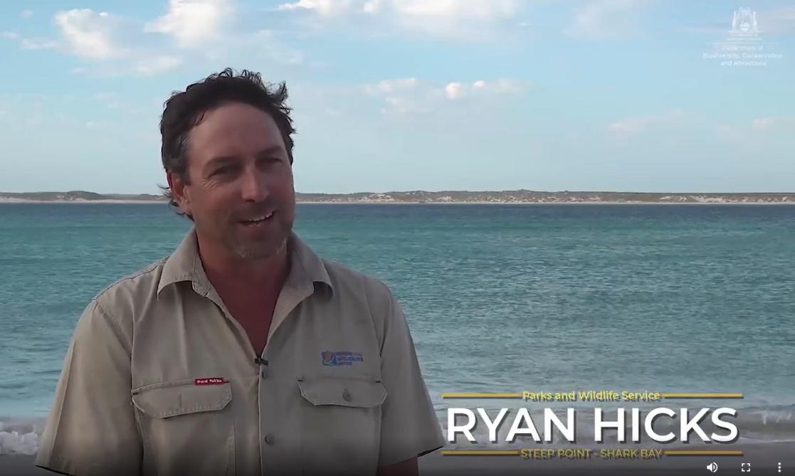
Return to 1616
Real-World Action Project
Dirk Hartog Island National Park Return to 1616 Ecological Restoration Project
What strategies are being used to protect Dirk Hartog Island National Park?
In this video, Ranger Ryan shares some of the ways in which biodiversity is being protected as part of the Dirk Hartog Island National Park ecological restoration project. Use this as an opportunity to take notes and develop your own questions for further inquiry. Check out the Island Protection brochure for more information.
2020_442-Dirk-Hartog-Island-Restoration-Project.pdf (pressidium.com)

Slide 5
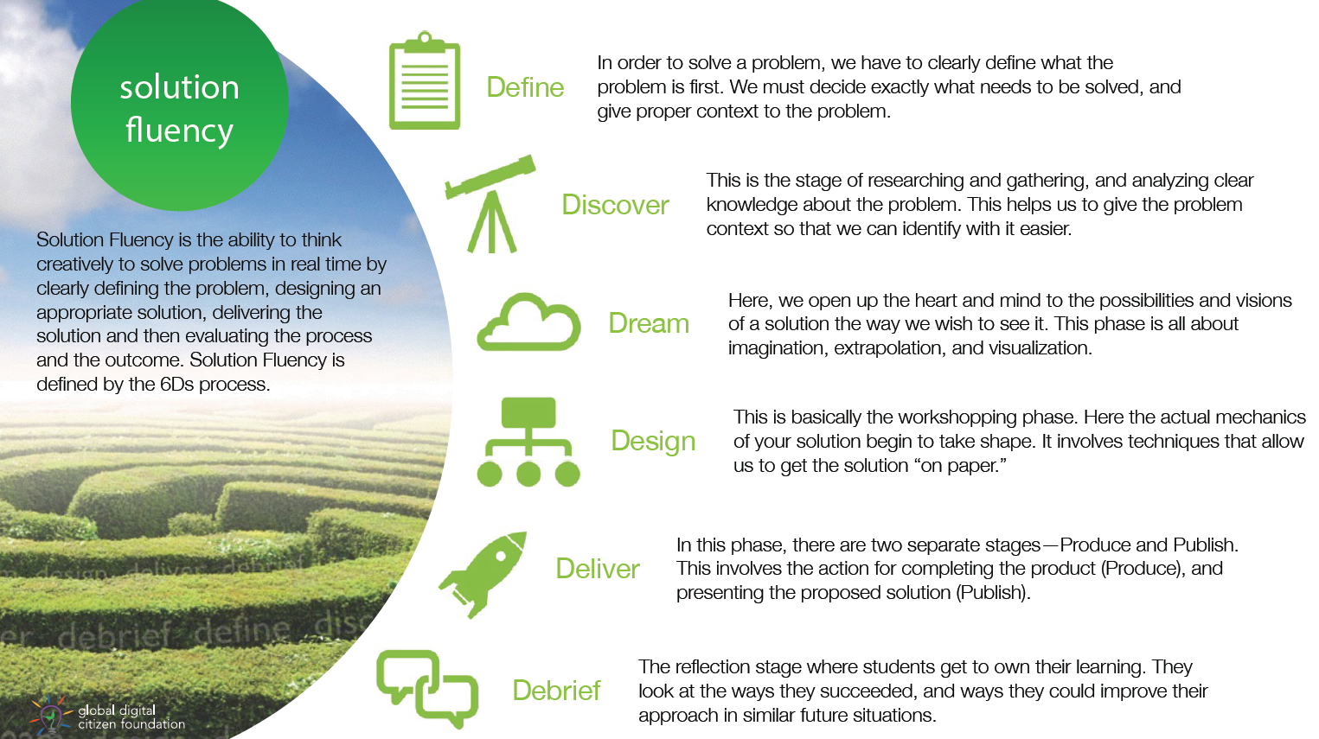
Return to 1616
Real-World Action Project
Dirk Hartog Island National Park Return to 1616 Ecological Restoration Project
Use Solution Fluency to lead the way…
Solution Fluency is a ‘design thinking’ model developed to help you create solutions to problems that matter to you. Use the following pages to capture your learning. Work as a class, small group, individually and/or remotely and complete one or more projects as time permits on your chosen topic.
Solution Fluency in Everyday Life – Wabisabi Learning

Slide 6
Return to 1616
Real-World Action Project
In order to solve a problem, we have to clearly define what the problem is first. We must decide exactly what needs to be solved, and give proper context to the problem.
What is the problem and what needs to be solved? Try to articulate the exact issue.

Slide 7
Return to 1616
Real-World Action Project
Dirk Hartog Island National Park Return to 1616 Ecological Restoration Project
This is the stage of researching and gathering, and analyzing clear knowledge about the problem. This gives the problem context so you can identify with it more easily.
What do we know and need to know about the problem? Use this page to gather your research.

Slide 8
Return to 1616
Real-World Action Project
Dirk Hartog Island National Park Return to 1616 Ecological Restoration Project
Here, we open up the heart and mind to the possibilities and visions of a solution the way we wish to see it. This phase is all about imagination, extrapolation, and visualization.
What amazing and wild ideas can we think of to solve this problem? How could we implement real-world action in a positive way?
Construct a…
Write to…
Invent a…
Create a…
Organise to…

Slide 9
Return to 1616
Real-World Action Project
Dirk Hartog Island National Park Return to 1616 Ecological Restoration Project
This is basically the workshopping phase. Here the mechanics of your solution begin to take shape. It involves techniques that allow us to get the solution “on paper.”
What’s the plan? Use this space to share the main steps you will take to achieve positive real-world action.
Step 1
Step 2
Step 3
Step 4
Write here
Write here
Write here
Write here

Slide 10
Return to 1616
Real-World Action Project
Dirk Hartog Island National Park Return to 1616 Ecological Restoration Project
In this phase, there are two separate stages – Produce and Publish. This involves the action for completing the product (Produce), and presenting the proposed solution (Publish).
Showcase your solution here! Present your solution to an audience if possible and deliver positive real-world action.

Slide 11
Return to 1616
Real-World Action Project
Dirk Hartog Island National Park Return to 1616 Ecological Restoration Project
The reflection stage is where you get to own your learning. You look at the ways you succeeded, and ways you could improve your approach in similar future situations.
Use this space to reflect on your learning.
What was great?
Even better if?

Slide 12
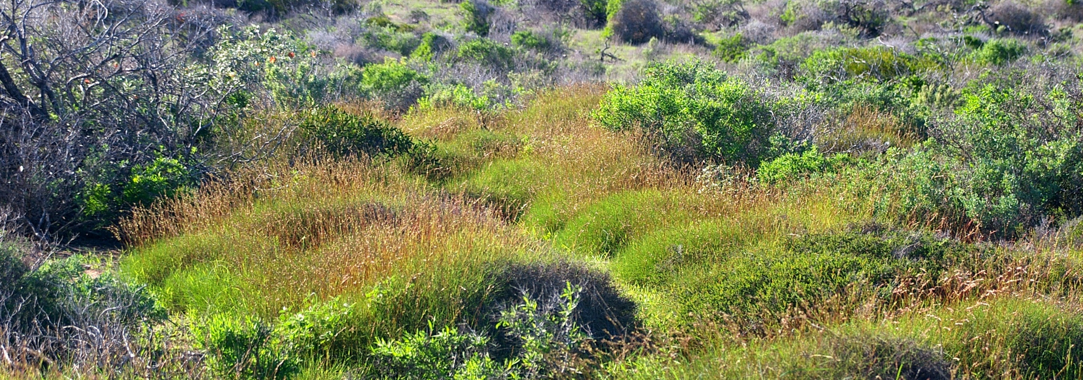
Return to 1616
Real-World Action Project
Dirk Hartog Island National Park Return to 1616 Ecological Restoration Project
Congratulations!
If you are reading this page, it is likely that you have completed a project that challenged you to take real-world action! We know there are issues affecting biodiversity in your region that you may feel strongly about.
Having freedom to choose a topic that captures your heart can dramatically enrich learning. This project allows you to select an aspect of a topic and work towards creating real-world action to make a difference. Most importantly, now is the time to celebrate your action with others, no matter how big or small the impact may be.
We hope you enjoyed being part of the solution and implementing positive real-world action!
Step 1
Consider biodiversity in your region. What are you most concerned about?
Step 2
Use Solution Fluency to lead you to create real-world action
Step 3
Share, celebrate and reflect on your achievement

