Slide 1
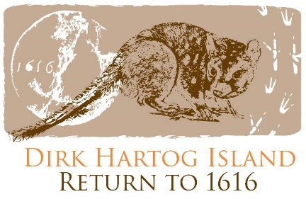
Return to 1616 Land Use at Dirk Hartog Island
Dirk Hartog Island National Park Return to 1616 Ecological Restoration Project
What do you know about land use at Dirk Hartog Island? How has the land been used? What was the impact on the environment? How is it used today?
Use your research skills to find out more about the way in which the land has been used over time and share your findings here.
Era | Land Use | Impact | My Thoughts
Pre-1616
1869-2009
2009-now
Aboriginal History
1616 Dirk Hartog Visited
1869-2009
Sheep Station
Return to 1616 Ecological Restoration Project

