Slide 1
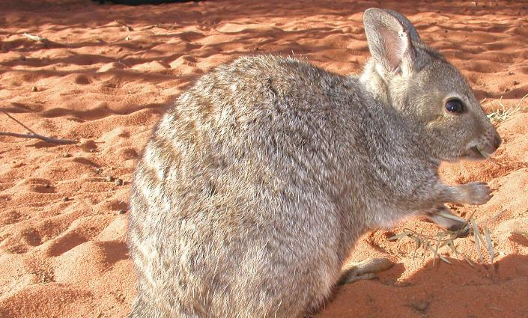
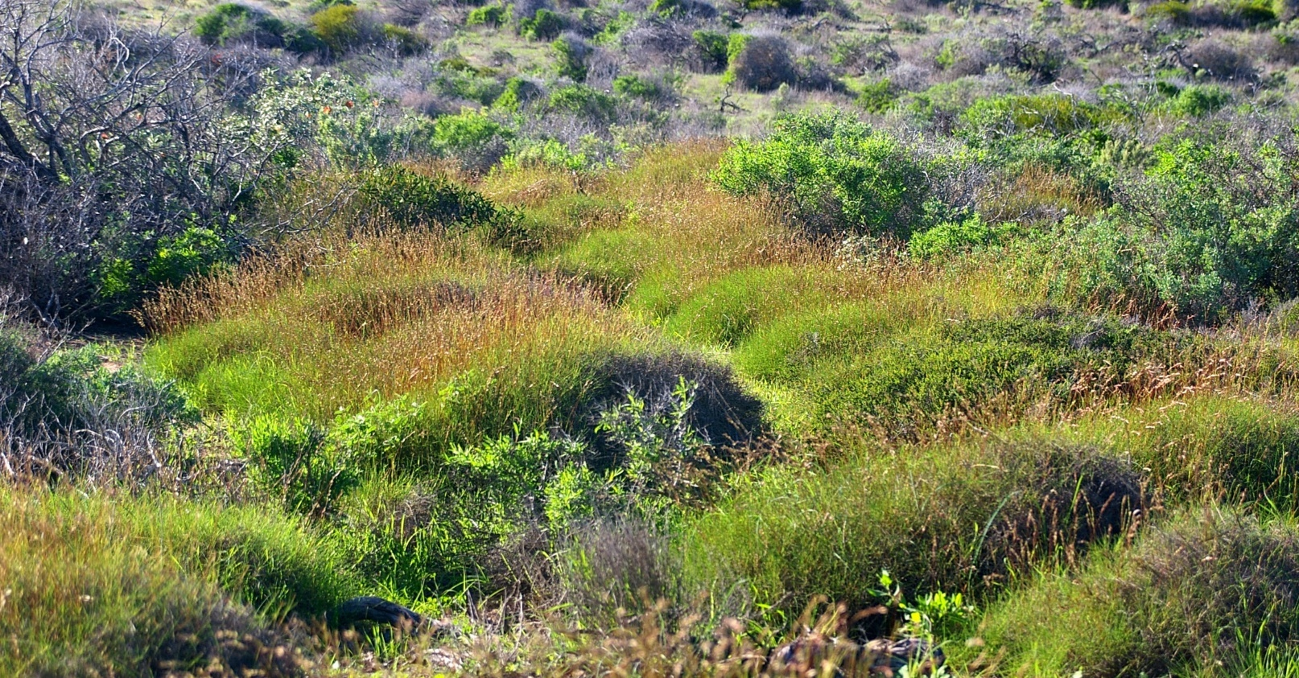

Dirk Hartog Island National Park
Return to 1616
Ecological Restoration Project
Education Package for Schools
Department of Biodiversity, Conservation and Attractions

Slide 2
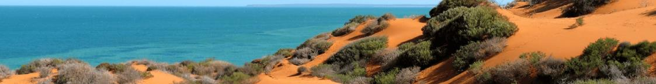
Dirk Hartog Island National Park
Return to 1616
Dirk Hartog Island National Park
Return to 1616
Ecological Restoration Project
Education Package
Prepared by Wendy Payne (Department of Biodiversity, Conservation and Attractions), Mandy Bamford (Ecologist), Nathan Ducker (Education Consultant), Michael Bryant (Education Consultant).
©Copyright DBCA 2024 except where otherwise stated.
The information contained in this publication is provided for general information purposes only. Neither the Department of Biodiversity, Conservation and Attractions, nor any of the contributors, accept any responsibility for any loss however caused, or sustained by any person who relies on it.
This education package includes information adapted from other DBCA publications. All photographs are used under Creative Commons (CC) licence. Solution Fluency and Information Fluency are used with permission from Lee Crockett.
Reproduction of this publication for educational or other non-commercial purposes is authorised subject to advance written notification to DBCA and appropriate acknowledgement. Reproduction of this publication for resale or other commercial purposes is prohibited without DBCA’s prior written permission. Reproduction of the photographs for any purpose is subject to DBCA’s and photograph author’s (if any) prior written permission.
For more information please contact: enquiries@dbca.wa.gov.au
Gorgon Barrow Island
Net Conservation Benefits Fund
www.gorgon-ncb.org.au

Slide 3
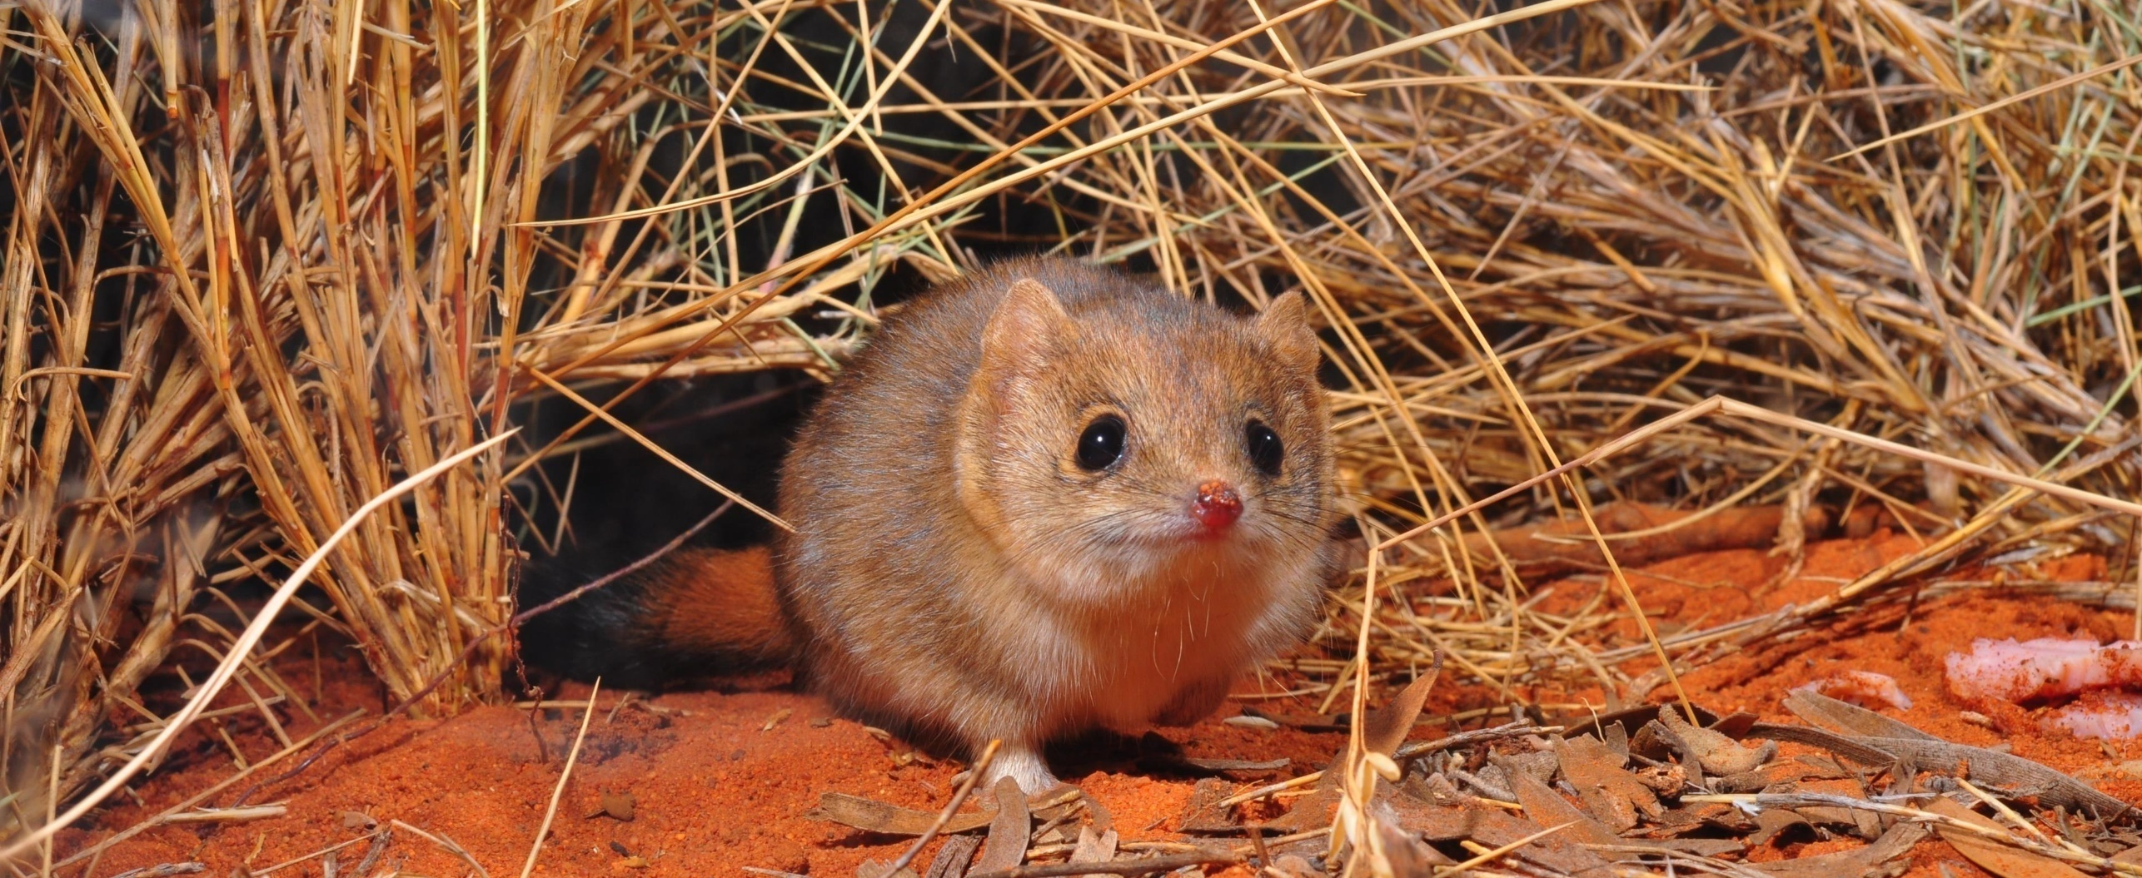

Dirk Hartog Island National Park
Return to 1616
Introduction
Dirk Hartog Island is Western Australia’s largest island. When visited by Dirk Hartog in 1616, the island was in pristine condition with a rich mammal fauna and flourishing vegetation. Since this time, introduced plants and animals have degraded the island causing the local extinction of native species. Return to 1616 is an ambitious program to restore the island’s natural ecosystems to how Dirk Hartog would have seen them. Introduced animals have been removed and native mammals are gradually being reintroduced.
These resources and activities have been designed to achieve a range of learning outcomes across curriculum areas – particularly HASS, Science and English.
After using the materials in Return to 1616 learners will be better able to:
describe how Dirk Hartog Island is being restored by the Return to 1616 project
provide examples of adaptations of species to their environment
describe interactions between animals in an ecosystem
describe predator prey relationships (food webs, food chains)
identify threats to native species
explain how our actions can have both positive and negative impacts on the environment
identify practical ways that we can protect threatened species.
Travel through time
Meet the unique wildlife
Be part of the solution

Slide 4
Dirk Hartog Island National Park
Return to 1616
Photo: Mark Cowan
Let’s begin your journey to Dirk Hartog Island National Park…

Slide 5
Dirk Hartog Island National Park
Return to 1616
How to Use this Resource
People will be driven to learn when they’re solving problems that matter to them. This resource is designed to engage learners in devising actions for real-world problems - big and small. Select an Inquiry Activity and let it lead the way. The Information Hub is there to support knowledge construction by learners. The Teacher Section is there to support teachers as they guide learners to achieve curriculum expectations.
Information Hub
Search here for information you need when you need it. Find the information that best suits your inquiry and use it for real-world action. Share the information with others.
Teacher Section
This section includes curriculum links and other supporting materials for busy teachers.
Student Activities
Browse activities to complement your current programs and curriculum. These can be used as ‘one-off’ activities or as a series.
Return to 1616 Background Information
Learn about the incredible project to restore the biodiversity of Dirk Hartog Island to its natural state.
Virtual Tour
Interact with 360-degree images within Google Earth to explore the island and the Return to 1616 project.
Inquiry Projects
Use ‘Information Fluency’ to guide your research or ‘Solution Fluency’ to guide you to real-world action!

Slide 6
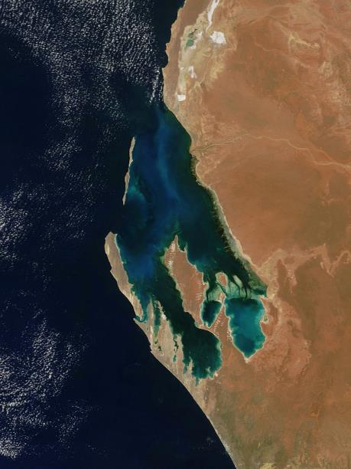
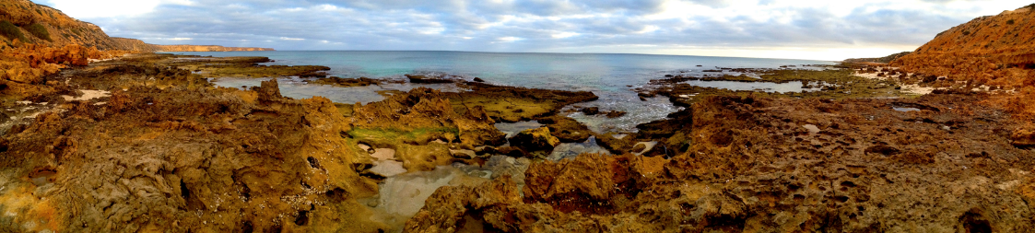
Return to 1616
Background Information
Dirk Hartog Island National Park
(Wirruwana)
Dirk Hartog Island (Wirruwana) lies within Shark Bay, which is the traditional land of the Malgana people. They know the island as Wirruwana and call the Shark Bay area Gutharraguda, meaning ‘two bays’.
The Malgana people are saltwater people, living around the water for the majority of their existence and have inhabited Shark Bay for more than 30,000 years.
Covering 63,300 hectares, Dirk Hartog Island National Park (Wirruwana) is WA’s largest and most western island, and lies within the Shark Bay World Heritage Area, 850 kilometres north of Perth. The Shark Bay World Heritage Area was inscribed on the UNESCO World Heritage List in 1991 recognising the area for its special natural values.

Slide 7
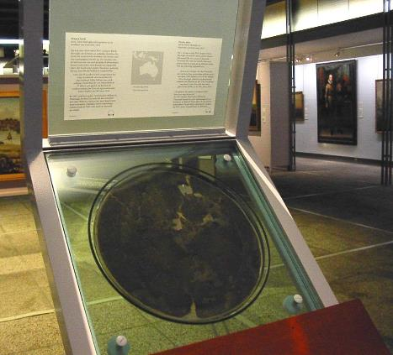
Return to 1616
Background Information
Dirk Hartog
On 25 October 1616, Dutch sea captain Dirk Hartog and the crew of the wooden-hulled, Dutch East India Company ship, Eendracht were the first Europeans to land on Western Australian soil when they set foot on the island. He nailed an engraved pewter plate to a post, leaving the first evidence of European landing in what would one day be called Australia. The pewter plate was inscribed with details of his journey. This was at Cape Inscription, also the site of an historic lighthouse and associated keeper's quarters.
The thin strip of land, dominated by scrub-covered sand dunes, is now named after the Dutch captain.
The island is about 80 kilometres long and varies between 3 and 12 kilometres wide. It was mined by Europeans for guano, used as a base for the pearling industry and was a pastoral station from 1860. In 2009, the majority of the land was purchased from the pastoralist by the Western Australian Government and declared a national park.

Slide 8
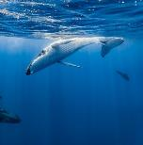
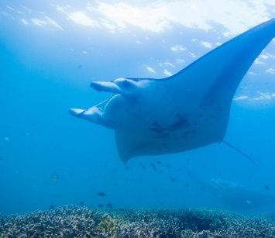
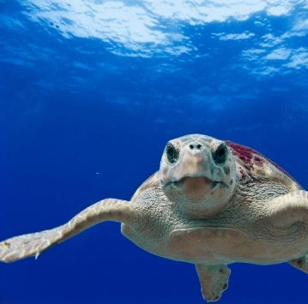
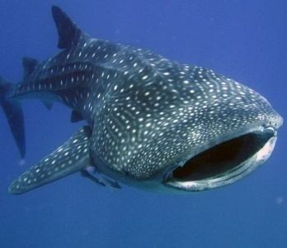
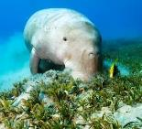
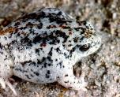
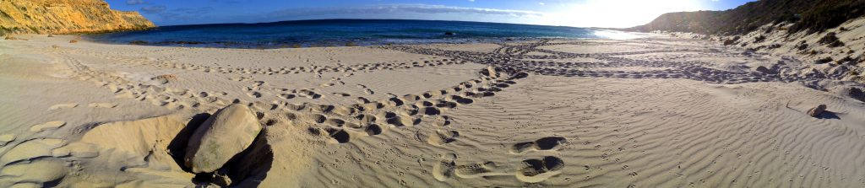
Return to 1616
Background Information
Dirk Hartog Island Locals
The western side of the island is dominated by tall exposed cliffs while protected beaches and shallow bays comprise the eastern coastline. The low shrubby vegetation harbours a range of animal life including the Dirk Hartog Island black and white fairy-wren, which is found nowhere else, and the northern sandhill frog whose distribution is limited to the Shark Bay area and Dirk Hartog Island.
Seabirds abound along the protected eastern coast of Dirk Hartog Island with species nesting on islands close to shore. Wildlife in the waters close to the island can be observed from a boat or while snorkelling or diving – manta rays throughout the year, whale sharks around the northern coastline in May and June and humpback whales in September. Dugongs travel to warmer waters around the island when the rest of Shark Bay’s waters are at their coldest.
Each summer thousands of loggerhead turtles return to Turtle Bay, the area where they emerged as hatchlings, to lay their eggs. Parks and Wildlife staff and volunteers have been monitoring this during annual surveys each January since 1994 and Turtle Bay is one of the most important loggerhead nesting areas in the southern hemisphere.

Slide 9
Return to 1616
Background Information
Decimation of Native Species
The island has experienced significant changes since Dirk Hartog landed there on 25 October 1616. Sheep and goats changed the vegetation, their grazing habits and trampling reducing the food and shelter available for native species. Feral cat predation added to the pressures on native species and made it impossible for some to survive.
Ten species of small mammals and marsupials, and one small bird did not survive the changes to the island’s ecology.
The Return to 1616 Ecological Restoration Project
brings hope for these species.
Boodie
Chuditch
Desert mouse
Dibbler
Shark Bay bandicoot
Heath mouse
Western grasswren
Greater stick-nest rat
Woylie
Shark Bay mouse
Brush-tailed mulgara

Slide 10
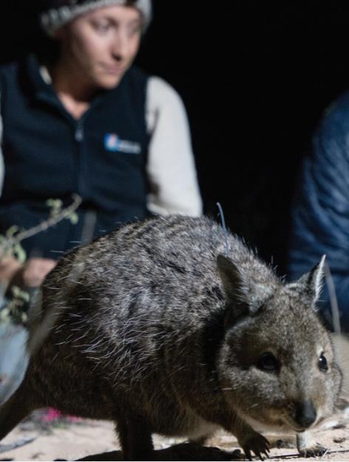
Return to 1616
Background Information
What is Return to 1616?
Welcome to the Dirk Hartog Island National Park Return to 1616 Ecological Restoration Project.
When Dirk Hartog landed on the island in 1616, the flora and fauna was in pristine condition.
Since this time, the island’s ecosystem has been degraded by:
• overgrazing by introduced animals such as goats and sheep, removing habitat and food for native animals
• the efficient hunting of native animal species by feral cats
• the proliferation of introduced weeds that smother native vegetation.
Their combined effect caused the extinction of many native animal species on the island.
In 2009, the majority of the island was purchased by the government and declared a national park. It is managed by the Department of Biodiversity, Conservation and Attractions (DBCA). Return to 1616 aims to restore the island to a more natural state and involves the removal of introduced animal species, the reintroduction of native animal species and management of weeds. It has removed introduced grazing animal species and the native vegetation is rejuvenating. It has eradicated feral cats making the island safe for the return of native animal species. It is managing weeds and aims to prevent the future establishment of pest species.
Come on a journey to explore the project, discover how it’s changing the face of the Dirk Hartog Island National Park and meet some of the native animals being returned.
Photo: Richard Manning

Slide 11
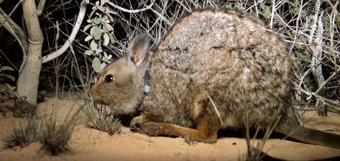
Return to 1616
Background Information
Help Arrives!
The exciting Return to 1616 Ecological Restoration Project is now breathing life back into Dirk Hartog Island with the eradication of feral animals now complete. The reintroduction of species that became locally extinct on the island during its pastoral days began in 2018 and further translocations will take place over 12 years.
Habitats are recovering with sheep declared eradicated in June 2016 and goats in November 2017. The feral animal eradication program was completed in October 2018 with eradication of feral cats declared. Over the next twelve years the lost species and two additional marsupials are being translocated to Dirk Hartog Island.
Although fauna reconstruction officially began when feral cat eradication was declared, there was a pilot release of the two hare-wallaby species in August/September 2017. Twelve each of the rufous hare-wallaby and banded hare-wallaby were translocated from Bernier and Dorre Islands. Monitoring with the aid of radio and GPS collars fitted prior to release showed the hare-wallabies to be doing well and breeding, with eight joeys observed in May 2018, in addition to eight previously recorded.
The first full-scale translocation of hare-wallabies involved the release of 90 banded and 50 rufous hare-wallabies from Bernier and Dorre Islands Nature Reserve onto Dirk Hartog Island in October 2018 with another 49 rufous hare-wallabies the following year bringing the total number of translocated rufous hare-wallabies to 112. The total number of Shark Bay bandicoots translocated is 99.
Preview video (45 seconds):
https://cdn-sharkbaywa.pressidium.com/wp-content/uploads/2017/04/Social-Media-video-MIN.mp4
In the spring of 2019, the hare-wallabies were joined by 26 dibblers, captive-bred at Perth Zoo and 71 Shark Bay bandicoots translocated from Bernier and Dorre Islands.

Slide 12
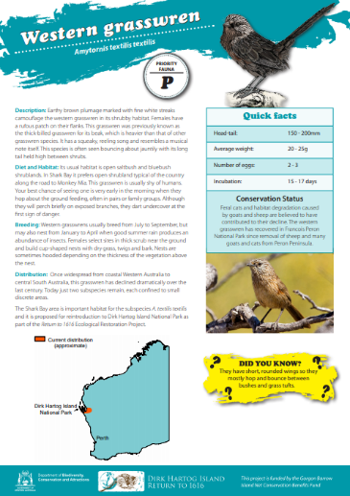
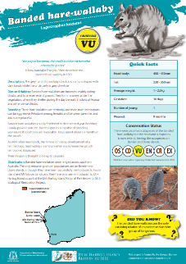
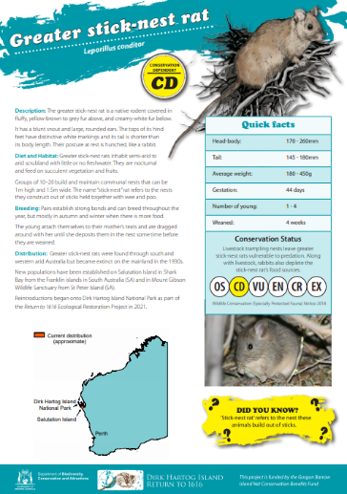
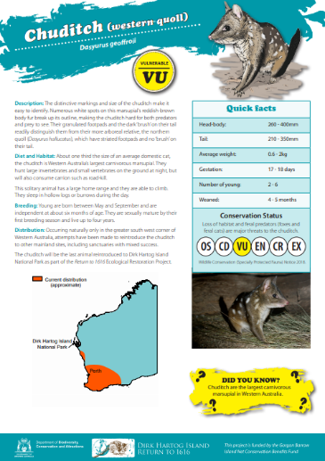
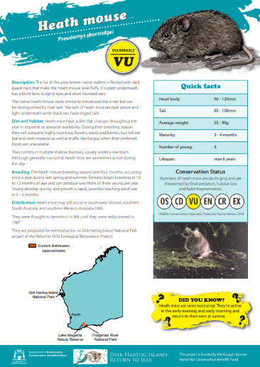
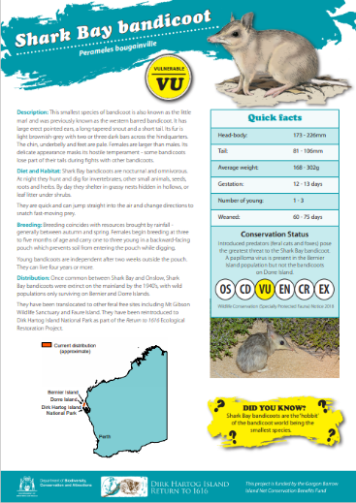
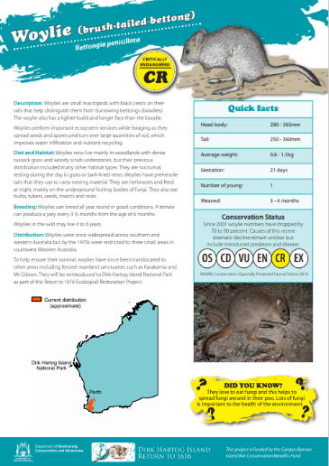
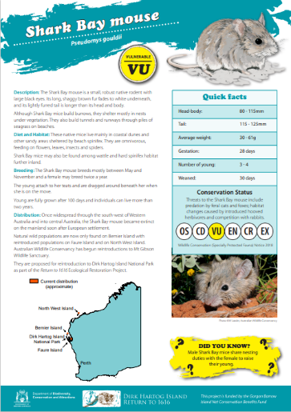
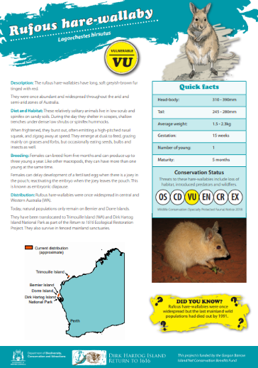
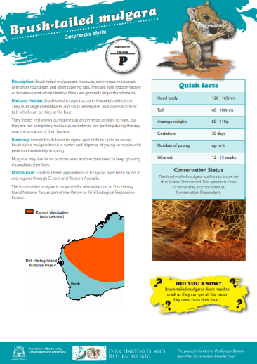
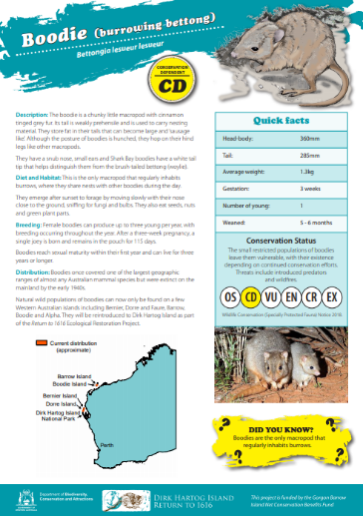
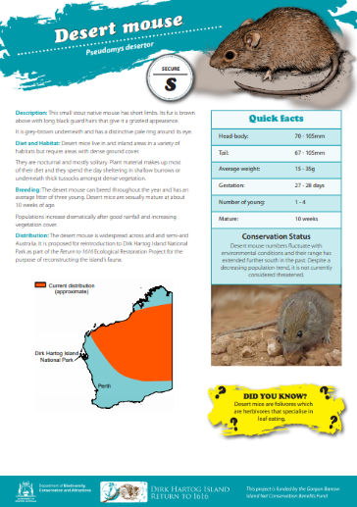
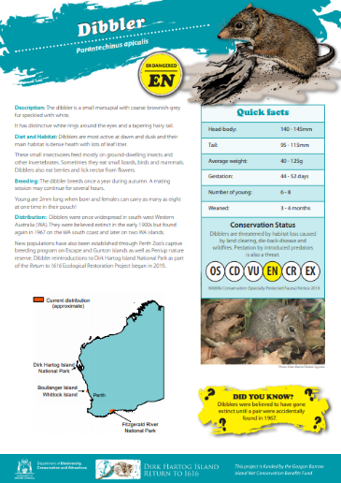
Return to 1616
Animal Factsheets
Find the key facts for each of the Return to 1616 animals from the Animal Factsheets including the: greater stick-nest rat, chuditch, heath mouse, western grasswren, Shark Bay bandicoot, Woylie, banded hare-wallaby, Shark Bay mouse, rufous hare-wallaby, brush-tailed mulgara, boodie, desert mouse, and dibbler.

Slide 13
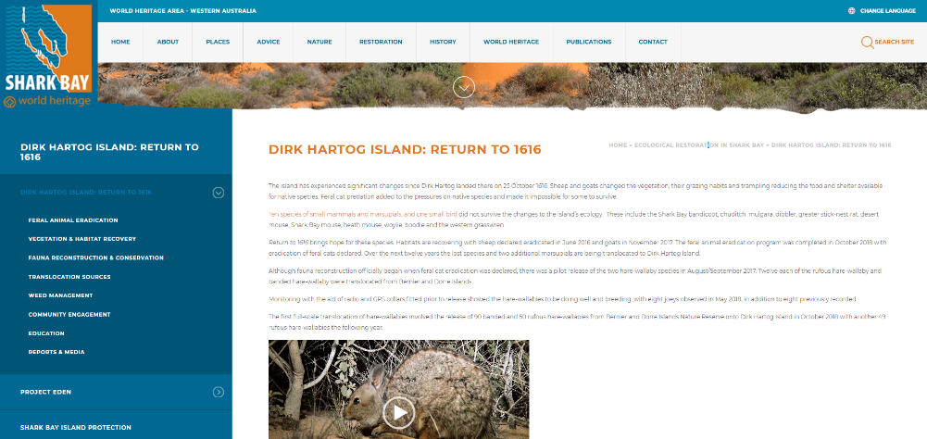
Return to 1616
Shark Bay World Heritage
Learn more about the Return to 1616 Ecological Restoration Project at www.sharkbay.org/restoration
www.sharkbay.org/restoration

Slide 14
Virtual Tour
Dirk Hartog Island National Park
Welcome to Dirk Hartog Island National Park Return to 1616 Ecological Restoration Project Virtual Tour.

Slide 15
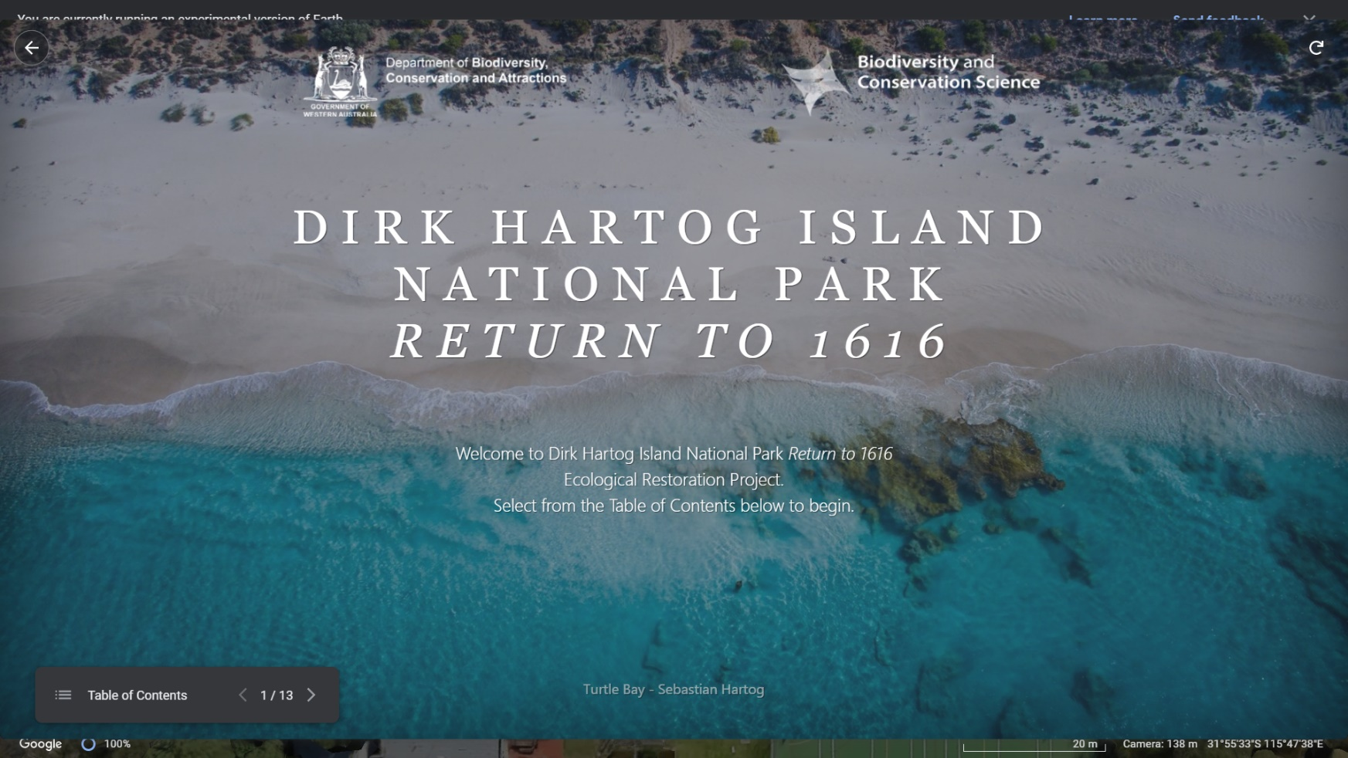
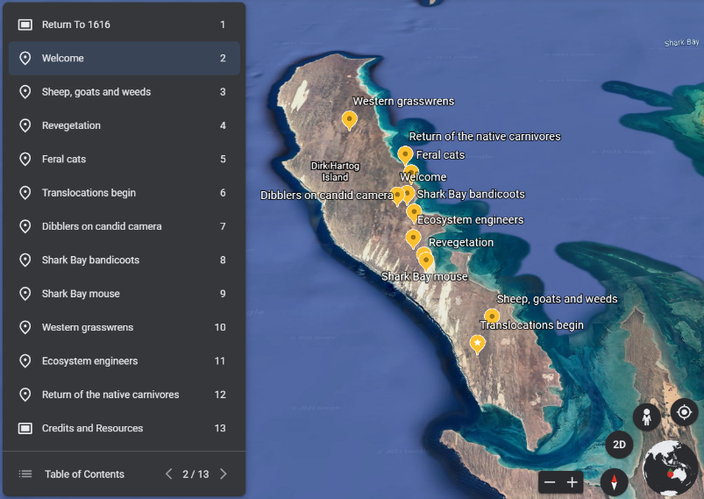
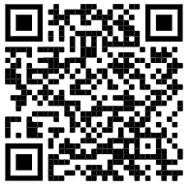

Return to 1616
Virtual Tour
Returning to 1616
Welcome to Dirk Hartog Island National Park Return to 1616 Ecological Restoration Project Virtual Tour. Use Google Earth or Kuula to explore the island and the Return to 1616 project. The following pages can be used by individuals/groups to record and share discoveries.
For each location, consider:
What did you find interesting?
What would you like to know?
Google Earth
About: This is designed for tablet devices and computers
Click here to begin
KUULA
About: KUULA is more interactive. This is best suited for computers or VR (virtual reality) Headsets like the Oculus Quest 2.
Click here to begin
VR Ready
www.sharkbay.org

Slide 16
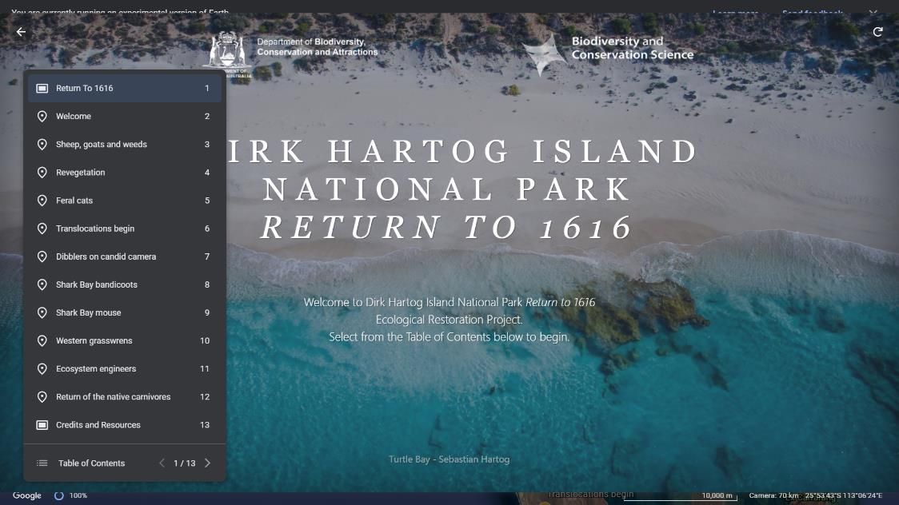
Return to 1616
Virtual Tour
Use this page to reflect on the information presented during your Dirk Hartog Island National Park virtual tour.
Google Earth Virtual Tour Site: Return to 1616 URL: Click here
What’s interesting about this location in the virtual tour?
What questions does this raise for you?
You are here

Slide 17
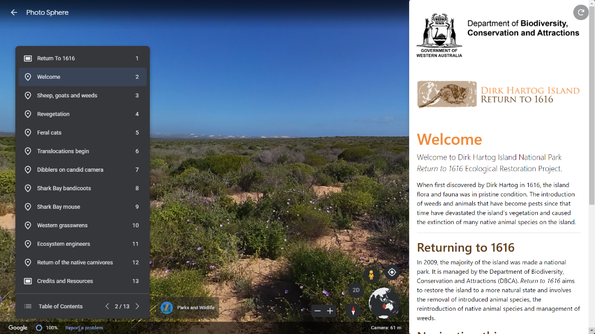
Return to 1616
Virtual Tour
Use this page to reflect on the information presented during your Dirk Hartog Island National Park virtual tour.
Google Earth Virtual Tour Site: Welcome URL: Click here
What’s interesting about this location in the virtual tour?
What questions does this raise for you?
You are here

Slide 18
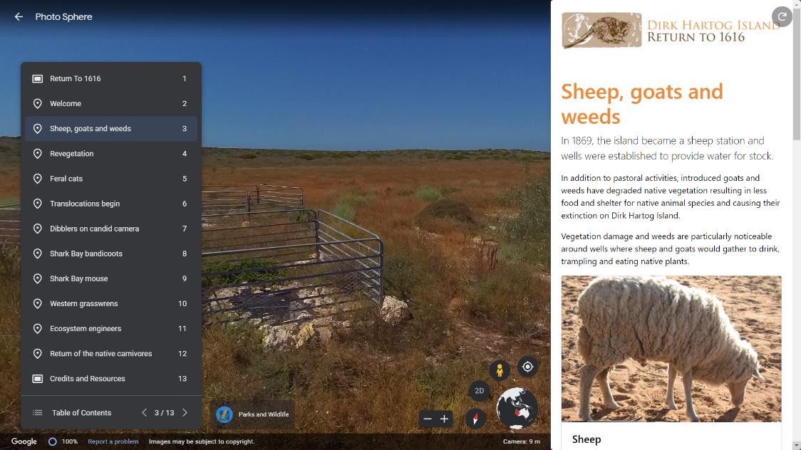
Return to 1616
Virtual Tour
Use this page to reflect on the information presented during your Dirk Hartog Island National Park virtual tour.
Google Earth Virtual Tour Site: Sheep, goats and weeds URL: Click here
What’s interesting about this location in the virtual tour?
What questions does this raise for you?
You are here

Slide 19
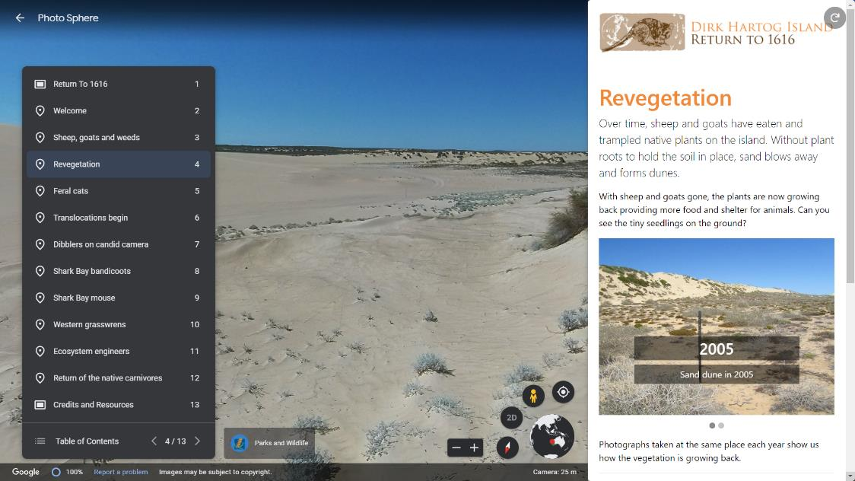
Return to 1616
Virtual Tour
Use this page to reflect on the information presented during your Dirk Hartog Island National Park virtual tour.
Google Earth Virtual Tour Site: Revegetation URL: Click here
What’s interesting about this location in the virtual tour?
What questions does this raise for you?
You are here

Slide 20
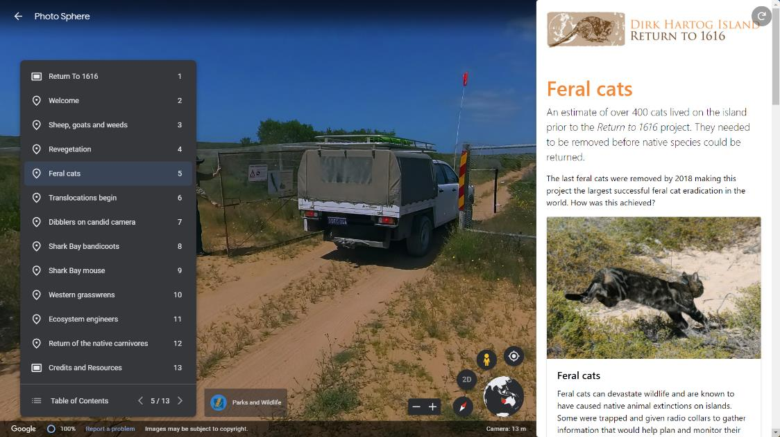
Return to 1616
Virtual Tour
Use this page to reflect on the information presented during your Dirk Hartog Island National Park virtual tour.
Google Earth Virtual Tour Site: Feral cats URL: Click here
What’s interesting about this location in the virtual tour?
What questions does this raise for you?
You are here

Slide 21
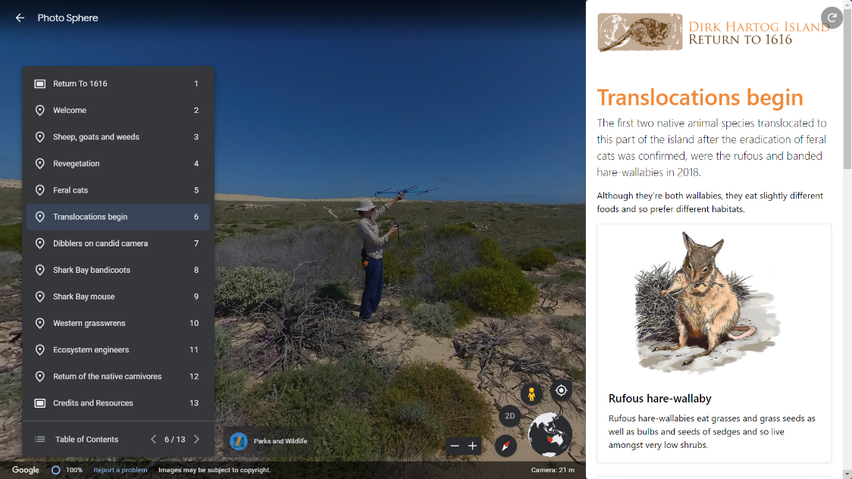
Return to 1616
Virtual Tour
Use this page to reflect on the information presented during your Dirk Hartog Island National Park virtual tour.
Google Earth Virtual Tour Site: Translocations begin URL: Click here
What’s interesting about this location in the virtual tour?
What questions does this raise for you?
You are here

Slide 22
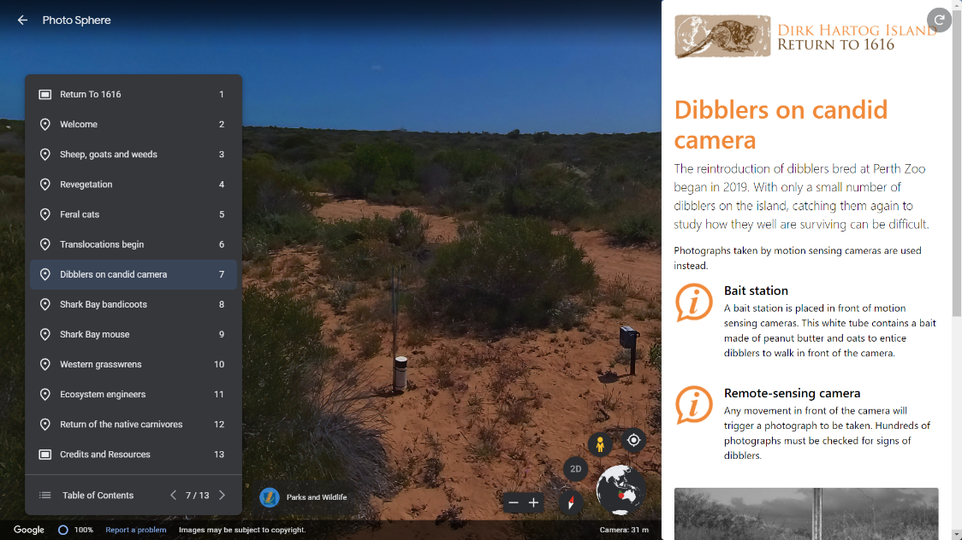
Return to 1616
Virtual Tour
Use this page to reflect on the information presented during your Dirk Hartog Island National Park virtual tour.
Google Earth Virtual Tour Site: Dibblers on candid camera URL: Click here
What’s interesting about this location in the virtual tour?
What questions does this raise for you?
You are here

Slide 23
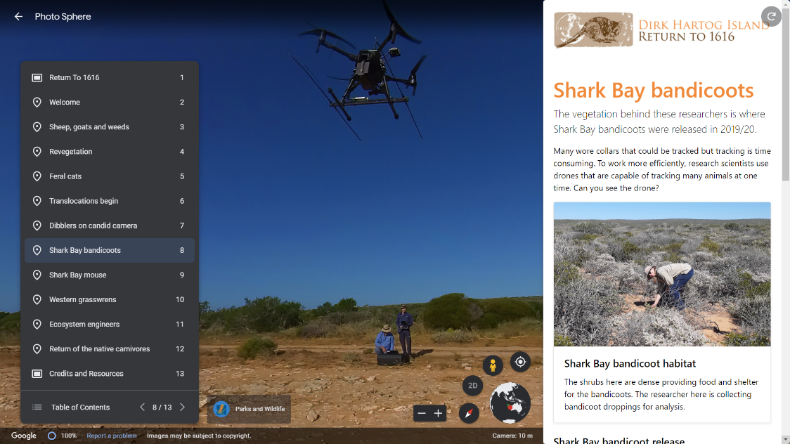
Return to 1616
Virtual Tour
Use this page to reflect on the information presented during your Dirk Hartog Island National Park virtual tour.
Google Earth Virtbal Tour Site: Shark Bay bandicoots URL: Click here
What’s interesting about this location in the virtual tour?
What questions does this raise for you?
You are here

Slide 24
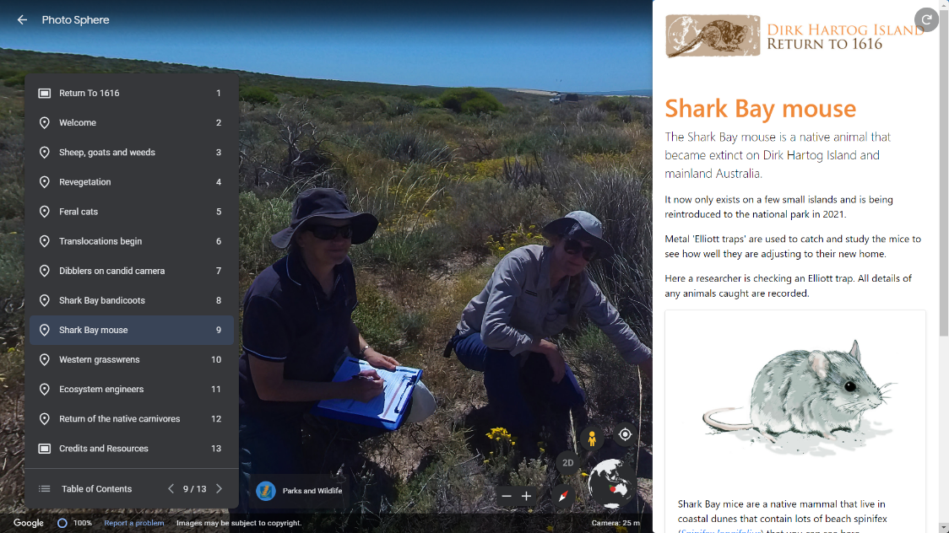
Return to 1616
Virtual Tour
Use this page to reflect on the information presented during your Dirk Hartog Island National Park virtual tour.
Google Earth Virtual Tour Site: Shark Bay mouse URL: Click here
What’s interesting about this location in the virtual tour?
What questions does this raise for you?
You are here

Slide 25
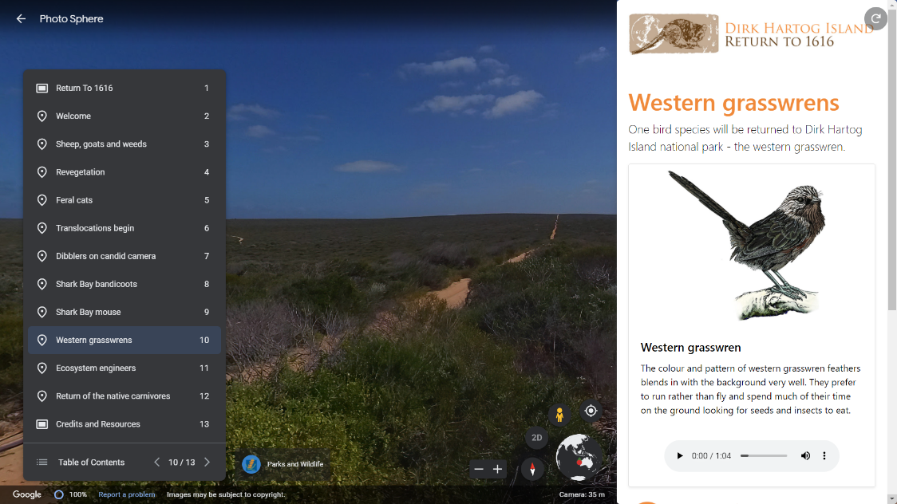
Return to 1616
Virtual Tour
Use this page to reflect on the information presented during your Dirk Hartog Island National Park virtual tour.
Google Earth Virtual Tour Site: Western grasswrens URL: Click here
What’s interesting about this location in the virtual tour?
What questions does this raise for you?
You are here

Slide 26
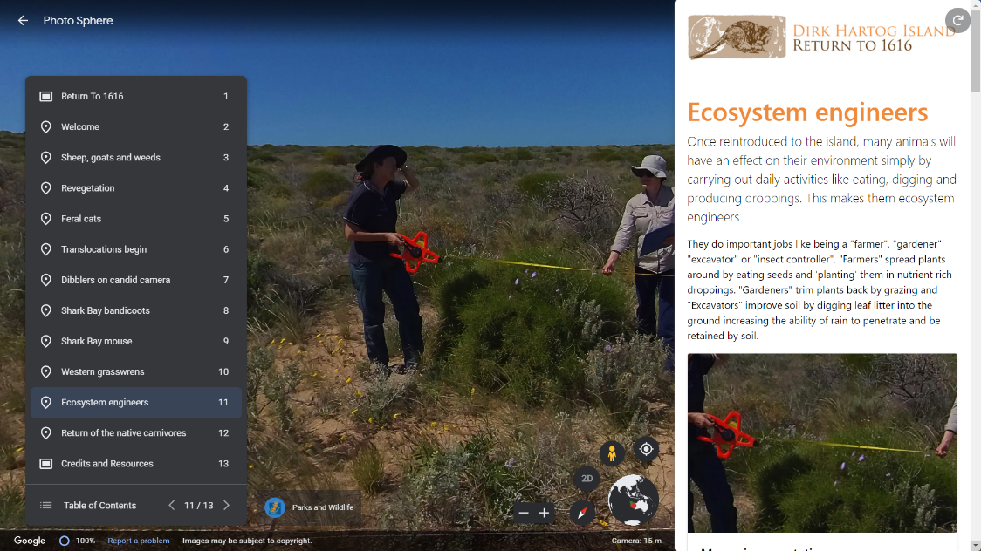
Return to 1616
Virtual Tour
Use this page to reflect on the information presented during your Dirk Hartog Island National Park virtual tour.
Google Earth Virtual Tour Site: Ecosystem engineers URL: Click here
What’s interesting about this location in the virtual tour?
What questions does this raise for you?
You are here

Slide 27
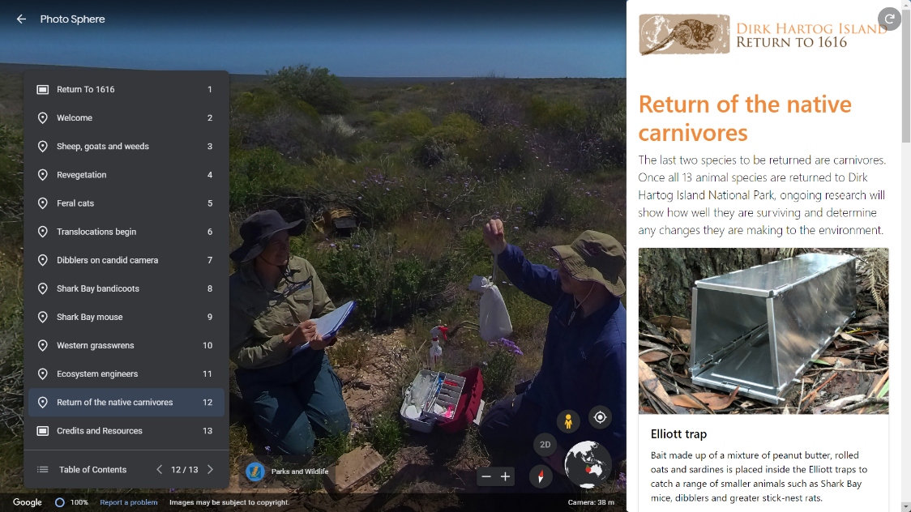
Return to 1616
Virtual Tour
Use this page to reflect on the information presented during your Dirk Hartog Island National Park virtual tour.
Google Earth Virtual Tour Site: Return of the native carnivores URL: Click here
What’s interesting about this location in the virtual tour?
What questions does this raise for you?
You are here

Slide 28
Return to 1616
Virtual Tour
Use this page to reflect on the information presented during your Dirk Hartog Island National Park virtual tour.
Google Earth Virtual Tour (for tablets and computers): Click here Kuula Virtual Tour (enhanced experience for computers and virtual reality headsets): Click here
Where did you visit during this virtual tour?
What is the name of the special conservation project on the island?
What three introduced animals have been removed from the island?
What is one native animal monitoring technique used on the island?
What else did you learn?
What would you like to learn?

Slide 29
Inquiry Project
Knowledge Construction
This project challenges you to be a researcher! Do you feel you have a strong understanding of biodiversity in the Shark Bay region? What would you like to know? Who would you like to share this information with to make a positive impact?

Slide 30
Return to 1616
Knowledge Construction Project
Your quest, should you choose to accept…
This project challenges you to be a researcher! It will help you to learn all about the animals being relocated to Dirk Hartog Island and why. It will challenge you to think about what you would like to know. Who could you share your research with to make a positive impact?
Having an opportunity to generate your own questions for a topic can dramatically enrich learning. This project is designed to engage you in a quality process to conduct meaningful research. Just make sure you work closely with your teacher/parents if you need help with difficult research questions. Most importantly, make time at the end to share, celebrate and reflect your learning with others, no matter how big or small.
Step 1
What do you know about the animals being returned to Dirk Hartog Island? What would you like to know?
Step 2
Use Information Fluency to lead you through a meaningful research process.
Step 3
Share and celebrate!

Slide 31
Return to 1616
Knowledge Construction Project
Ideas for research
Twelve mammal species and one bird species are being translocated onto Dirk Hartog Island. Many of these species are threatened with extinction and listed on the Australian Government’s list of nationally threatened species. Select one of the animal species to research and use the Information Fluency inquiry method to lead you through.
Brush-tailed mulgara
Banded hare-wallaby
Boodie
Chuditch
Desert mouse
Dibbler
Shark Bay bandicoot
Heath mouse
Western grasswren
Greater stick-nest rat
Woylie
Shark Bay mouse
Rufous hare-wallaby
Extension Ideas
These ideas come from the Australian Curriculum, Cross-Curriculum Priorities, Sustainability. Use Information Fluency to help you unpack and research these ideas in relation to the Dirk Hartog Island Return to 1616 Ecological Restoration Project.
Systems
All life forms, including human life, are connected through ecosystems on which they depend for their wellbeing and survival.
Sustainable patterns of living rely on the interdependence of healthy social, economic and ecological systems.
World Views
World views that recognise the dependence of living things on healthy ecosystems, and value diversity, are essential for achieving sustainability.
World views are formed by experiences at personal, local, national and global levels, and are linked to individual and community actions for sustainability.
Futures
The sustainability of ecological systems is achieved through informed individual and community action that values local and global equity and fairness across generations into the future.
Actions for a more sustainable future reflect values of care, respect and responsibility, and require us to explore and understand environments.
Designing action for sustainability requires an evaluation of past practices, the assessment of scientific and technological developments, and balanced judgements based on projected future economic, social and environmental impacts.
Sustainable futures result from actions designed to preserve and/or restore the quality and uniqueness of environments.
The biosphere is a dynamic system providing conditions that sustain life on Earth.

Slide 32
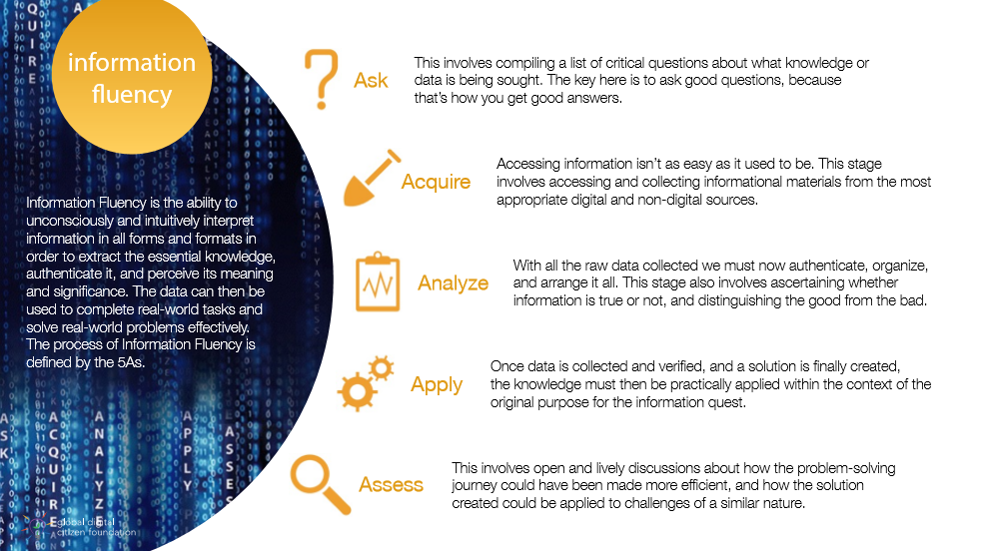
Use Information Fluency to lead the way…
Information Fluency is designed to lead you through an inquiry research process. Use the following pages to capture your learning. Work as a class, small group, individually and/or remotely and complete one or more projects as time permits.
Return to 1616
Knowledge Construction Project
Information Fluency is the ability to subconsciously and intuitively interpret information in all forms and formats in order to extract the essential knowledge, authenticate it, and perceive its meaning and significance. The data can then be used to complete real-world tasks and solve real-world problems effectively. The process of Information Fluency is defined by the 5As.
How Information Fluency Leads to Rewarding Research for Learners – Wabisabi Learning

Slide 33
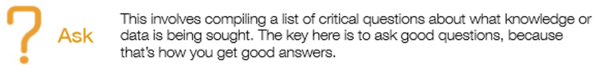

Return to 1616
Knowledge Construction Project
This involves compiling a list of critical questions about what knowledge or data is being sought. The key here is to ask good questions, because that’s how you get good answers.
What would you like to know? Generate a list of good questions about one of the animals being returned as part of the Dirk Hartog Return to 1616 project.
What would you like to know? Generate a list of good questions about one of the animals being returned as part of the Dirk Hartog Return to 1616 project.
Brush-tailed mulgara
Banded hare-wallaby
Boodie
Chuditch
Desert mouse
Dibbler
Shark Bay bandicoot
Heath mouse
Western grasswren
Greater stick-nest rat
Woylie
Shark Bay mouse
Rufous hare-wallaby

Slide 34

Return to 1616
Knowledge Construction Project
This stage involves accessing and collecting informational materials from the most appropriate digital and non-digital sources.
How can we find out? Use dot points to record key information from trustworthy sources.

Slide 35
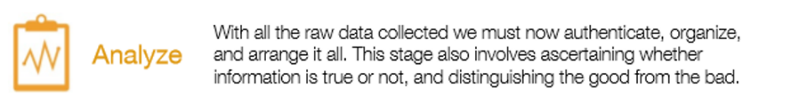
Return to 1616
Knowledge Construction Project
With all the raw data collected we must now authenticate, organise and arrange it. This stage also involves ascertaining whether information is true or not, and distinguish the good from the bad.
Heading
Key points
Heading
Key points
Heading
Key points
Heading
Key points
Heading
Key points
Organize the most useful and accurate information here

Slide 36

Return to 1616
Knowledge Construction Project
Once data is collected and verified, and a solution is finally created, the knowledge must then be practically applied within the context of the original purpose for the information quest.
Can you put this new information to good use? How will you share your findings to best suit the purpose? Prepare your information for your target audience and share a copy here.

Slide 37

Return to 1616
Knowledge Construction Project
This involves open and lively discussions about how the problem-solving journey could have been made more efficient, and how the solution created could be applied to challenges of a similar nature.
How could you have been more efficient and accurate in your research process? What aspects of the process will you use in your next research project? How did your target audience respond?
What was great?
Even better if?

Slide 38
Inquiry Project
Real-World Action
This project challenges you to take real-world action! Are there issues affecting biodiversity in the Shark Bay region that you feel strongly about? Would you like to make a positive difference? Would you prefer to be part of the problem or part of the solution? Would you like to help to solve problems that matter to you?

Slide 39
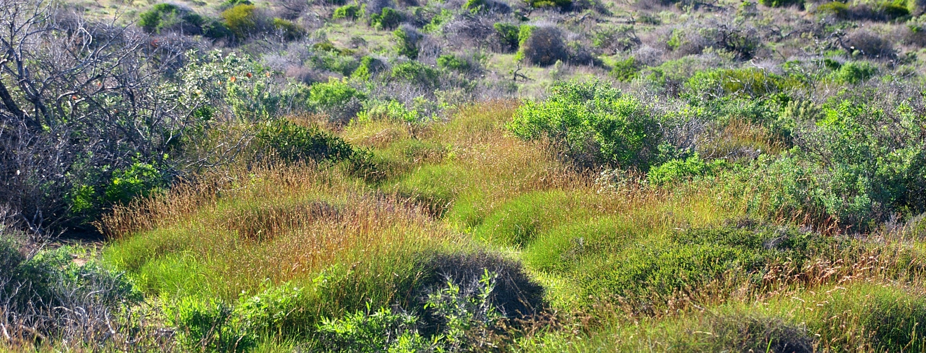
Return to 1616
Real-World Action Project
Your challenge, should you choose to accept…
This project challenges you to take real-world action! Are there issues affecting biodiversity at Dirk Hartog Island, Shark Bay or your local region that you feel strongly about? Would you like to make a positive difference? Would you prefer to be part of the problem or part of the solution? Would you like to help to solve problems that matter to you?
Having freedom to choose a topic that captures your heart can dramatically enrich learning. This project allows you to select an aspect of a topic and work towards creating real-world action to make a difference. Just make sure you work closely with your teacher/parents to ensure your actions are safe, appropriate and have maximum impact. Most importantly, make time at the end to share and celebrate your action with others, no matter how big or small the impact may be.
Step 1
Consider biodiversity at Dirk Hartog Island, Shark Bay or your local region. What are you most concerned about?
Step 2
Use Solution Fluency to lead you to create real-world action
Step 3
Share, celebrate and reflect on your achievement

Slide 40
Return to 1616
Real-World Action Project
What are you concerned about?
Consider impacts on biodiversity at Dirk Hartog Island, Shark Bay or your local region. What are you most concerned about? Learn more from Ranger Ryan and use the ideas on this page to highlight and discuss issues affecting your region. When you are ready, use Solution Fluency to guide you to develop a real-world solution.
Climate Change
Careless Behaviour
Increasing ocean acidification
Rising sea temperatures
Changing oceanographic patterns
Rising sand temperatures
Increasing intensity and frequency of storms
Rising sea levels
Trophic cascades, phase shifts
Litter, including risks to animals from getting caught or ingesting
Increased light pollution and habitat disturbance
Introduction of pests (foxes, cats, non-native rodents, Asian house gecko)
Outbreaks of invasive pests with cascading effects
Marine Debris
Smothering and entangling wildlife
Ingestion causing death or injury
Discarded fishing gear
Invasive Plants
Invasive Animals
Outbreaks of weed species
Weeds can grow quickly and smother native plants. Return to 1616 aims to manage some of the worst weeds already on the island such as ruby dock, iceplant, false sowthistle and caster oil plant.
Accidental fires
Off-road driving causing damage to vegetation and animal habitat
Risk to animals from vehicles travelling too fast at night
Accidental introduction of disease and introduced species from vehicles
What makes me CURIOUS?
What makes me CONCERNED?
What do I want to CREATE?

Slide 41
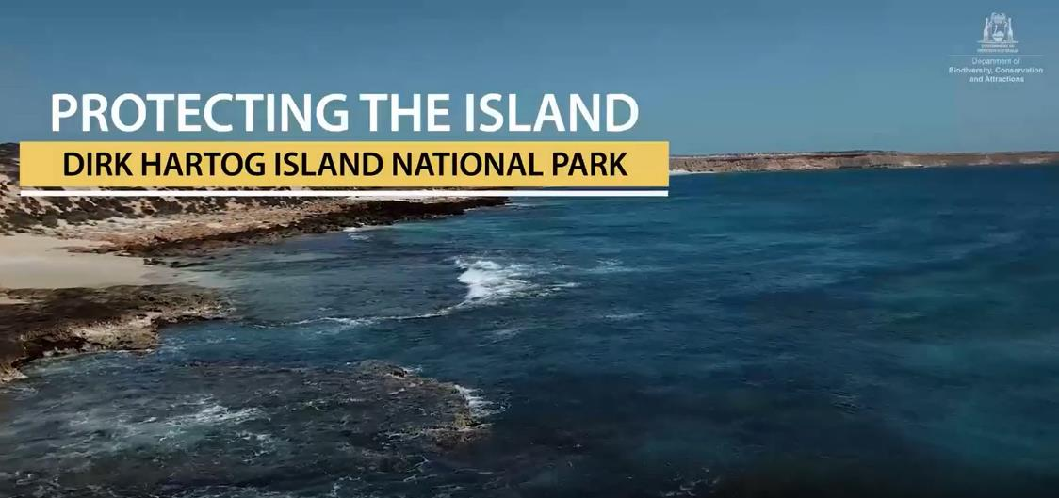

Return to 1616
Real-World Action Project
What strategies are being used to protect Dirk Hartog Island National Park?
In this video, Ranger Ryan shares some of the ways in which biodiversity is being protected as part of the Dirk Hartog Island National Park ecological restoration project. Use this as an opportunity to take notes and develop your own questions for further inquiry. Check out the Island Protection brochure for more information.
2020_442-Dirk-Hartog-Island-Restoration-Project.pdf (pressidium.com)

Slide 42

Return to 1616
Real-World Action Project
Use Solution Fluency to lead the way…
Solution Fluency is a ‘design thinking’ model developed to help you create solutions to problems that matter to you. Use the following pages to capture your learning. Work as a class, small group, individually and/or remotely and complete one or more projects as time permits on your chosen topic.
Solution Fluency in Everyday Life – Wabisabi Learning

Slide 43

Return to 1616
Real-World Action Project
In order to solve a problem, we have to clearly define what the problem is first. We must decide exactly what needs to be solved, and give proper context to the problem.
What is the problem and what needs to be solved? Try to articulate the exact issue.

Slide 44

Return to 1616
Real-World Action Project
This is the stage of researching and gathering, and analyzing clear knowledge about the problem. This gives the problem context so you can identify with it more easily.
What do we know and need to know about the problem? Use this page to gather your research.

Slide 45

Return to 1616
Real-World Action Project
Here, we open up the heart and mind to the possibilities and visions of a solution the way we wish to see it. This phase is all about imagination, extrapolation, and visualization.
What amazing and wild ideas can we think of to solve this problem? How could we implement real-world action in a positive way?
Construct a…
Write to…
Invent a…
Create a…
Organise to…

Slide 46

Return to 1616
Real-World Action Project
This is basically the workshopping phase. Here the mechanics of your solution begin to take shape. It involves techniques that allow us to get the solution “on paper.”
What’s the plan? Use this space to share the main steps you will take to achieve positive real-world action.
Step 1
Step 2
Step 3
Step 4
Write here
Write here
Write here
Write here

Slide 47

Return to 1616
Real-World Action Project
In this phase, there are two separate stages – Produce and Publish. This involves the action for completing the product (Produce), and presenting the proposed solution (Publish).
Showcase your solution here! Present your solution to an audience if possible and deliver positive real-world action.

Slide 48

Return to 1616
Real-World Action Project
The reflection stage is where you get to own your learning. You look at the ways you succeeded, and ways you could improve your approach in similar future situations.
Use this space to reflect on your learning.
What was great?
Even better if?

Slide 49

Return to 1616
Real-World Action Project
Congratulations!
If you are reading this page, it is likely that you have completed a project that challenged you to take real-world action! We know there are issues affecting biodiversity in your region that you may feel strongly about.
Having freedom to choose a topic that captures your heart can dramatically enrich learning. This project allows you to select an aspect of a topic and work towards creating real-world action to make a difference. Most importantly, now is the time to celebrate your action with others, no matter how big or small the impact may be.
We hope you enjoyed being part of the solution and implementing positive real-world action!
Step 1
Consider biodiversity in your region. What are you most concerned about?
Step 2
Use Solution Fluency to lead you to create real-world action
Step 3
Share, celebrate and reflect on your achievement

Slide 50
Student Activities
These activities are designed to be used individually or to create a collection of activities.

Slide 51










Return to 1616
Boneheads 3D Scanned Models
Why do most animals have skulls? Why do skulls vary so much? What can we learn from the features of an animal skull? What do they tell us about animal habits and adaptations? Would you like a close up look at some real skulls in 3D? To learn more, explore the Boneheads activity (from the comfort of your screen). Find it on the Return to 1616 education page or click here.
Scientists rely on clues to solve mysteries. We can get clues about animals from their skulls. Examine nasal passages, teeth and ear holes to find out how an animal lived, hunted, or obtained food, what senses it relied on and whether it was a predator or prey. Use the Boneheads Activity Sheets to study carnivore and herbivore skulls particularly the teeth and eye sockets. Then look at each of the Return to 1616 skulls and use the clues to determine whether the animal was predator, prey, or both. Can you match each skull to the correct Return to 1616 animal?
Click here to download

Slide 52
Return to 1616
Status of Species
Biodiversity is the variety of plants, animals, micro-organisms and ecosystems that constitute our living environment— is not static; it is constantly changing. It can be increased by genetic change and evolutionary processes, and it can be reduced by threats which lead to population decline and extinction. Our knowledge of biodiversity increases when scientists discover new species.
Australia’s biodiversity is currently in decline; in Australia, more than 1,700 species and ecological communities are known to be threatened and at risk of extinction.
The key threats to species are loss, degradation and fragmentation of habitat, invasive species and altered fire regimes. Other threats include unsustainable use and management of natural resources, changes to the aquatic environment and water flows and climate change
Threatened fauna and flora may be listed in any one of the following categories:
Threatened species under the EPBC Act | Department of Agriculture, Water and the Environment
Conservation dependent
Vulnerable
Endangered
Critically endangered
Extinct in the wild
Extinct
Boodie
Chuditch
Desert mouse
Dibbler
Shark Bay bandicoot
Heath mouse
Western grasswren
Greater stick-nest rat
Woylie
Shark Bay mouse
Brush-tailed mulgara
Search reliable, up-to-date information (such as the Return to 1616 animal factsheets available from www.sharkbay.org)
to identify the current status of the Return to 1616 animals and use arrows to indicate their current status.

Slide 53

Return to 1616
Conducting Scientific Surveys
Scientific surveys are used to estimate populations of plant and animal species. The information gathered can be used to monitor the health of species and habitats.
Watch this video to learn about the scientific methods used to collect data for the Dirk Hartog National Park Return to 1616 Ecological Restoration Project.
Take a virtual tour to find out more.
Google Earth - This is designed for tablet devices and computers. Click here to begin
KUULA - KUULA is more interactive. This is best suited for computers or VR (virtual reality) Headsets like the Oculus Quest 2. Click here to begin
Why are ecological surveys conducted?
How are ecological surveys conducted?
What is the information collected from ecological surveys used for?

Slide 54

Return to 1616
Conservation Codes and Threatened Species
Scientific surveys are used to estimate populations of plant and animal species. These codes are used to represent the status of populations.
The Department of Biodiversity, Conservation and Attractions maintains the following listings:
threatened native plants (flora)
threatened animals (fauna)
threatened ecological communities
Protection is needed for critically endangered, endangered or vulnerable species and ecological communities because they are under identifiable threat of extinction (species) or collapse (ecological communities). Research these lists for Western Australia and reflect on your thoughts below.
What did I LEARN?
What makes me CONCERNED?
What do I want to DO?

Slide 55
Return to 1616
Native Animal Survey
Conduct a survey around your school or another location and record your observations below. It may be helpful to work in a small team and/or you may also like to use a tally or include other information such as observed behaviour or location. Enjoy the opportunity to tune into nature.
Insects Sighted
Reptiles Sighted
Birds Sighted
Mammals Sighted
Can you source reliable identification methods to research the species sighted? Can you indicate which species are native to the area?

Slide 56

Return to 1616
Animal Research
My animal is:
My animal eats:
This is what my animal looks like:
An interesting fact about my animal:
My animal moves by:
My animal lives:
The enemies of my animal are:
Brush-tailed mulgara
Banded hare-wallaby
Boodie
Chuditch
Desert mouse
Dibbler
Shark Bay bandicoot
Heath mouse
Western grasswren
Greater stick-nest rat
Woylie
Shark Bay mouse
Rufous hare-wallaby

Slide 57
Return to 1616
Create a Fact Sheet
Would you like to help others learn more about the animals at Dirk Hartog Island? Investigate a species that inhabits the island and create your own fact sheet to share. Find out which species live on the island at: DHI-Other-animals.pdf (pressidium.com)
Animal
Description
Diet and Habitat
Breeding
Distribution
Status
Picture

Slide 58



Return to 1616
Biodiversity Brochure
Western Australia’s biodiversity is threatened. Would you like to do something to help? Create an information brochure that informs people about the biodiversity of Dirk Hartog Island and the importance of the Return to 1616 project.
Useful sites for information:
https://parks.dpaw.wa.gov.au/park/dirk-hartog-island
https://www.sharkbay.org/restoration/dirk-hartog-island-return-1616/
Tips for designing an effective brochure:
Create a colourful and eye-catching cover for your brochure.
Organise your information so it flows logically and present your ideas clearly.
Group similar types of ideas together so the reader knows exactly what each section discusses.
Answer the 5 Ws: Who? What? Where? When? Why?
Your brochure shouldn't contain so much information that it overwhelms the reader.
Make your brochure as attractive, appealing, and informative as you can.
Balance text with illustrations and use plenty of colour.
Use descriptive and precise writing.
Edit text for grammar, punctuation, spelling, and capitalization.
Decide on what type of folding the brochure will feature.
Consider using software like Microsoft Word or Publisher, Apple Pages or via online applications like Canva, MyCreativeShop, or Printing Press.
https://templates.office.com/en-au/travel-brochure-tm33746274
https://www.canva.com/create/brochures/

Slide 59
Return to 1616
Discovery Day
Would you like to share a positive story? Would you like to inspire others? Help your teacher set up a discovery day for a younger class to introduce them to the animals being returned to Dirk Hartog Island as part of the Return to 1616 project. Set up a series of stations around the classroom for self-guided learning in small groups. On the day, set a timer to go off every 8 minutes. When it goes off, groups rotate to the next activity.
Ideas for stations:
Memory Game
Students play the Return to 1616 memory game to reinforce the animal appearance and names.
Wild Challenge Game
Learners play the Return to 1616 Wild Challenge card game to understand the strengths of each animal.
Guess Who?
Students play the Guess Who game to reinforce animal appearances.
Create a Video Quiz
Students choose a series of short videos to learn about some of the Return to 1616 animals and attempt a short quiz.
Rufous hare-wallaby (0:29)
https://www.youtube.com/watch?v=fhqvW5zC0HA
Banded hare-wallaby (1:12)
https://www.youtube.com/watch?v=iJyd_TuLKaY
Dibbler (3:39)
https://www.youtube.com/watch?v=Ai9ZLAE5wAs
Woylie (1:04)
https://youtu.be/gdzEHaTAR40
Stick nest rat (1:50)
https://youtu.be/Vm3qYfuVMfk
Drawings
Students use the Return to1616 animal fact sheets to create drawings of their favourite (drawings to include appearance, features, habitat, food, predators etc).
Models
Students create a plasticine model of their favourite animal.
Boodie
Chuditch
Desert mouse
Dibbler
Shark Bay bandicoot
Heath mouse
Western grasswren
Greater stick-nest rat
Woylie
Shark Bay mouse
Brush-tailed mulgara

Slide 60





Return to 1616
Habitat Diorama
What is a habitat? What makes up a habitat? What would happen if habitats changed? What do the Return to 1616 animals need? Do they all need the same habitat? What are some of the specific requirements?
Refer to the Return to 1616 animal factsheets, conduct some internet research or read a good book about animal habitats to develop your understanding. Some good books include:
A Hollow is a Home - Abbie Mitchell, Astred Hicks
Whose Habitat is That? - Lucile Piketty
Amazing Animal Earth - Alessandra Yapp.
Prepare a blueprint or rough sketch of your diorama design before you begin construction.
Suggested materials:
Shoebox or tissue box
Different types of paper
Air-dry clay
Random items: pipe cleaners, popsicle sticks,
tissue paper, buttons, scrap fabric, beads, seeds,
nuts, leaves, etc.
Magazines
Glue
Markers.
Gather pictures of the habitat and the animal to use for inspiration. Start making the plants and animals you would like to showcase in the habitat. You can use clay, cut them out, draw them on paper or use papier mache. Create the background for the habitat diorama and finally, use the shoebox to complete the habitat. Put the background in the back and place the animals and plants you have created towards the front.
Challenge: Choose one of the Return to 1616 animals and create a diorama to replicate their ideal habitat.

Slide 61

Return to 1616
Science Endeavour
What would a day in the life of an environmental scientist be like? Consider the Dirk Hartog Return to 1616 Ecological Restoration Project. Watch this video and refer to Measuring Wildlife Changes in Dirk Hartog Island National Park to learn more about environmental survey methods and reflect on your learning below.
What do environmental scientists do?
How do they do it?
How does it help?

Slide 62

Return to 1616
National Park Treasure Hunt
This A-Z treasure hunt game will help you to tune into your surroundings. Could you create one for the Shark Bay region? See how many things you can notice on your next visit to a National Park.
A = Ant. Can you find an ant out exploring?
B = Birds next. What bird created this nest?
C = Chewed leaf. What has eaten this leaf?
D = Dew. Can you find any moisture on a plant or the ground?
E = Earthworm
F = Feather. What bird left this clue?
G = Green leaf
H = Hollow. Can you spot a good place for an animal to live?
I = Insect. Can you find an insect?
J = Jewel. Can you find something you think is treasure?
K = Kangaroo
L = Ladybug
M = Moss or mushroom
N = Nut. Can you see any signs of animals eating the seeds?
O = Orange. Can you find something orange?
P = Poo. What animal left this dropping?
Q = Quick animal. Find something moving fast
R = Reptile. Can you see any cold-blooded animals?
S = Sign. What does it say?
T = Tree sap.
U = Underground. Can you find something that lives underground?
V = Vine
W = Web. Can you see a spider in a web?
X = Xanthorrea. Another word for grasstree. Can you find one?
Y = Y shaped stick
Z = Zoo. Can you find something that could be in a zoo?

Slide 63
Return to 1616
History of Dirk Hartog Island
Have you ever been to Dirk Hartog Island? Consider using the virtual tour to learn more about the environment. Share your perceptions below:
The following people are recognised in the history of Dirk Hartog Island. What would you expect their perceptions of the environment to be in their era? Work with your classmates to research, prepare and share a series of presentations or dramatized interviews to learn more about these people?
My perceptions:
Malgana People
1616 Dirk Hartog
1697 Willem de Vlamingh
1772 Louis Aleno de St Aloüarn
1801 Emmanuel Hamelin
1818 Rose and Louis de Freycinet
1869 Francis Louis von Bibra
1907 John and James Withnell
1969 Sir Thomas Wardle
Now:
Scientist Kelly-view
Ranger Ryan-view

Slide 64



Return to 1616
Who was Dirk Hartog?
25 October 1616
The first recorded European landing
on Dirk Hartog Island in Shark Bay,
Western Australia
What do we know about Dirk Hartog?
Research Dirk Hartog to learn more and share any interesting points here?
What would you like to find out?

Slide 65

Return to 1616
Land Use at Dirk Hartog Island
What do you know about land use at Dirk Hartog Island? How has the land been used? What was the impact on the environment? How is it used today?
Use your research skills to find out more about the way in which the land has been used over time and share your findings here.
Era | Land Use | Impact | My Thoughts
Pre-1616
1869-2009
2009-now
Aboriginal History
1616 Dirk Hartog Visited
1869-2009
Sheep Station
Return to 1616 Ecological Restoration Project

Slide 66



Return to 1616
Create a Diary Extract
In 1699, William Dampier described what is thought to be a banded hare-wallaby in his diary:
Can you imagine being one of the European crew members arriving in Australian waters, coming ashore, and seeing one of the Return to 1616 animals for the very first time? Create a journal extract from the point of view of a member of the expedition describing one of the Return to 1616 animals.
Write here:
Boodie
Chuditch
Desert mouse
Dibbler
Shark Bay bandicoot
Heath mouse
Western grasswren
Greater stick-nest rat
Woylie
Shark Bay mouse
Brush-tailed mulgara

Slide 67


Return to 1616
Positive Persuasion
The Return to 1616 Project has facilitated the reintroduction of many species of animals to Dirk Hartog Island’s ecosystem. Choose one of the animals and research their importance and the threats they face. Using your research, consider actions that will help to ensure the survival of the species.
Challenge: Prepare a persuasive text to encourage others to support and implement positive actions to protect your animal.
This activity is intended to encourage a positive and respectful approach to protecting Australia’s threatened animals. Explore persuasive writing and learn how it is different to whining and complaining. For example, https://www.youtube.com/watch?v=hD9arWXIddM
Guiding Questions
What are the key actions that will help your animal to survive?
What would you like to achieve through persuasive text?
Who will be your target audience?
How will you present your persuasive text for positive impact (poster, newspaper article, letter, etc.)?

Slide 68




Return to 1616
Online Quiz
Challenge yourself to answer as many questions as you can about ecological conservation and Dirk Hartog Island.
Click Here to Begin!
https://forms.office.com/r/RHF7UbuYMk

Slide 69












Return to 1616
Colouring Activities
Dirk Hartog Island National Park Return to 1616 Ecological Restoration Project
Have fun while you learn about the animals being returned to Dirk Hartog Island National Park. Colour in the animals being translocated to the island including:
Rufous hare-wallaby
Banded hare-wallaby
Dibbler
Shark Bay bandicoot
Boodie
Greater stick-nest rat
Brush-tailed mulgara
Shark Bay mouse
Western grasswren
Woylie
Chuditch
Can you also draw and colour the correct habitat and food eaten by each of these animals?

Slide 70
Wild Challenge Playing Cards
This printable set of cards features animals from Dirk Hartog Island including original and introduced species. Enjoy endless opportunities for education and fun!

Slide 71










Return to 1616
Wild Challenge Playing Cards
Print out and play the Return to 1616 card game Wild Challenge. Have fun while you learn about the animals being returned to Dirk Hartog Island National Park. Print and construct your own playing cards here. Follow the instructions below and explore more games and activities on the upcoming pages. Have fun and enjoy learning at the same time!
Click here to Download

Slide 72









Return to 1616
Wild Challenge Card Games
GUESS WHO?
This is a pair guessing game.
Display all of the cards.
Each person secretly selects a mystery animal without telling their opponent.
Try to guess your partner’s mystery animal by asking yes/no questions.
1616 MEMORY MATCHING GAME
This game uses two sets of cards. The objective is to collect the most pairs of cards.
Shuffle the cards and lay them on the table, face down, in rows.
On each turn, a player turns over any two cards (one at a time) and keeps them if the cards match.
If successful matching a pair the player keeps the cards and gets another turn.
When a player turns over two cards that do not match, those cards are turned face down again (in the same position) and it becomes the next player’s turn.
The trick is to remember which cards are where.
The person with the most pairs at the end of the game wins
Download printable cards here!

Slide 73







Return to 1616
Food Chains
Can you use the Return to 1616 playing cards to create food chains? Research food chains and select an appropriate method to create and display energy flow. Cards can be downloaded here.
Food chains show who eats whom in the environment. Every living thing needs food to survive. A food chain shows the pathway that energy and nutrients follow through an ecosystem. Conduct further research to see how many food chains you can create using the Return to 1616 playing cards.

Slide 74










Return to 1616
Food Web
Many food chains make up a food web. Conduct some research to learn more about food webs and how they represent energy flow. Can you use the Return to 1616 playing cards to create a food web such as the example below? Can you create some different examples? Share and discuss your food webs with others. As an extension, you may like to find a way to represent other aspects such as plants and invertebrates.Cards can be printed from here.

Slide 75




Return to 1616
Trophic Levels
Can you use the Return to 1616 playing cards to represent trophic levels? Research trophic levels and select an appropriate method to create and display your example. Cards can be printed from here. Identifying trophic levels can be quite challenging and may not always provide an accurate representation, consider contacting an expert to help.
Tertiary Consumers
Sun
Secondary Consumers
Primary Consumers
Primary Producers

Slide 76
Information Hub
The following presentation was developed by Elaine Horne to outline the Return to 1616 Ecological Restoration Project and the results.

Slide 77

Return to 1616
Dirk Hartog Island National Park
Ecological Restoration Project

Slide 78

The Vision
A special place with healthy vegetation and ecosystem processes which supports a suite of reintroduced native mammal species.
The removal of introduced grazing animals (sheep and goats) and feral predators (cats).
The ecological restoration of the island is appreciated and strongly supported by the community.

Slide 79

Dirk Hartog Island

Slide 80
The story before…
Dirk Hartog, the first European to make landfall on Western Australia, landed on the island in 1616 and left an inscribed plate.
Dirk Hartog Island (in the Shark Bay World Heritage Property) is the largest island off the Western Australian coast at about 62,000 ha.
Pastoralism established from 1867 – 2009.
Grazing of introduced herbivores.
Invasion of feral predators (cats) 19th and early 20th Century.

Slide 81

The plan to restore an ecosystem
Eliminate feral and non-native animals from the island,
Habitat regeneration and fauna recovery,
Reintroductions,
Ecotourism & community support,
Continued scientific research.

Slide 82

Feral Control - Introduced Herbivores - Goats and Sheep
Over 5,000 sheep and 11,000 goats have been removed from Dirk Hartog Island. Habitat and vegetation has shown recovery.

Slide 83

Sheep and Goat Eradication
Aerial shooting commenced
#
Last ? 2 sheep
shot, Judas goats remaining.
Numbers of sheep and goats removed from Dirk Hartog Island

Slide 84

Sheep and Goat Eradication

Slide 85

Feral Control - Introduced Predator Feral Cats
Feral cats were removed using a mixture of baiting and traps.
Specially trained dogs, automated cameras and sand pads were used to check for any remaining feral cats.
Translocation of native fauna back to the island began once it was declared feral cat free in 2018.

Slide 86




Fauna Monitoring
Track counts
Trapping
Diggings
Radio telemetry
IR remote cameras
Spotlighting

Slide 87




Dirk Hartog Island Small Vertebrate Monitoring
Using pitfall traps and Elliott traps, this study began in 2007 and has been running for 13 years.
Its function is to monitor the changes in vertebrate animal numbers before and after feral animal removal.

Slide 88




Fauna Reconstruction
Translocation strategies are developed for each species.
10 mammal species and one bird species will be reintroduced to the island and two additional mammal species will be introduced over ten years.
Translocations began, after feral cats were declared eradicated, with two hare-wallaby species.

Slide 89
Vegetation Cover Change

Slide 90


Dirk Hartog Island Vegetation Monitoring
Vegetation photo points

Slide 91



Weed Management
Weed survey, 68 species, distributions mapped.
Assessed using DBCAs invasive plant prioritisation process
Weed management plan developed.
Monitor island access points, part of biosecurity plan.

Slide 92
Mammals for Re-Introduction
DHI Mammals for Re-Introduction
^{Boodie - Bettongia lesueur,}
Woylie - Bettongia penicillata,
Shark Bay Bandicoot - Perameles bougainville,
^{Chuditch - Dasyurus geoffroii,}
Brush-tailed Mulgara - Dasycercus blythi,
Dibbler - Parantechinus apicalis,
Greater Stick-nest Rat - Leporillus conditor,
Desert Mouse – Pseudomys desertor,
Shark Bay Mouse - Pseudomys gouldii,
Heath Mouse - Pseudomys shortridgei.
Additional mammals for introduction to DHI
Banded Hare-wallaby - Lagostrophus fasciatus.
Rufous Hare-wallaby - Lagorchestes hirsutus.
Bird species for introduction to DHI
^{Thick-billed grasswren}

Slide 93

Banded hare-wallaby
Reintroductions began in 2017

Slide 94

Rufous hare-wallaby
Reintroductions began in 2017

Slide 95

Shark Bay bandicoot
Reintroductions began in 2019

Slide 96

Restoration of DHI Ecosystem
involves management of an island ecosystem,
would result in original, more complex ecosystems and increased biodiversity,
would preserve threatened species and important habitats,
achieves the aims of its National Park status and World Heritage listing,
would be a world showcase of successful rehabilitation and conservation.

Slide 97


Return to 1616…
This presentation was developed by Elaine Horne to outline the Return to 1616 Ecological Restoration Project and the results.

Slide 98
Teacher Section
Education Package for Schools
Department of Biodiversity, Conservation and Attractions

Slide 99
Dirk Hartog Island National Park
Return to 1616
How to Use
Learners will be passionate about learning when it involves solving problems that matter to them. This resource is designed to facilitate learner engagement in real-world action, big or small. Select an Inquiry Activity and let it lead the way. The Information Hub is there to support knowledge construction. Student Activities provide more opportunities to enrich your program. The Teacher Section is there to support teachers as they support learners in their achievement of curriculum expectations.
Information Hub
Search here for information you need when you need it. Find the information that best suits your inquiry and use it for real-world action. Share the information with others.
Teacher Section
This section includes curriculum links and other supporting materials for busy teachers.
Student Activities
Browse activities to complement your current programs and curriculum. These can be used as ‘one-off’ activities or as a series.
Return to 1616 Background Information
Learn about the incredible project to restore biodiversity of Dirk Hartog Island to its natural state.
Virtual Tour
Interact with 360-degree images within Google Earth to explore the island and the Return to 1616 project.
Inquiry Projects
Use ‘Information Fluency’ to guide your research or ‘Solution Fluency’ to guide you to real-world action!

Slide 100
Suitable Year Levels
Where to use this education package
These resources align with the Achievement Standards from the Australian Curriculum and feature Assessment Pointers developed by the Western Australian School Curriculum and Standards Authority (SCSA).
Please use them in a way that will work best for you (data projector, student devices or printed worksheets). It will usually be best to display and discuss the key learning intentions as a group before selecting methods to capture evidence of learning. For younger learners, some activities will be best done as a class.
Resource | Achievement Standards | F | 1 | 2 | 3 | 4 | 5 | 6 | 7 | 8 | 9 | 10
Factsheets | Science, HASS, English |  |  |  |  |  |  |  |  |  |  | 
Virtual Tour | Science, HASS, English |  |  |  |  |  |  |  |  |  |  | 
Inquiry Project – Knowledge Construction | Science, HASS, English |  |  |  |  |  |  |  |  |  |  | 
Inquiry Project – Real-World Action | Science, HASS, English, Technologies |  |  |  |  |  |  |  |  |  |  | 
Boneheads | Science |  |  |  |  |  |  |  |  |  |  | 
Status of Species | Science |  |  |  |  |  |  |  |  |  |  | 
Conducting Scientific Surveys | Science |  |  |  |  |  |  |  |  |  |  | 
Conservation Codes and Threatened Species | Science, HASS, English |  |  |  |  |  |  |  |  |  |  | 
Native Animal Survey | Science |  |  |  |  |  |  |  |  |  |  | 
Animal Research | HASS, Science, English |  |  |  |  |  |  |  |  |  |  | 
Create a Fact Sheet | HASS, Science, English |  |  |  |  |  |  |  |  |  |  | 
Biodiversity Brochure | English, Science, HASS, Technologies |  |  |  |  |  |  |  |  |  |  | 
Discovery Day | Science, HASS, English |  |  |  |  |  |  |  |  |  |  | 
Habitat Diorama | Technologies, Science, HASS |  |  |  |  |  |  |  |  | 
Science Endeavour | Science, HASS |  |  |  |  |  |  |  |  |  |  | 
National Park Treasure Hunt | Science |  |  |  |  |  |  |  |  | 
History of Dirk Hartog Island | HASS, English, Science |  |  |  |  |  |  |  |  |  |  | 
Who was Dirk Hartog? | HASS, English |  |  |  |  |  |  |  |  |  |  | 
Land Use at Dirk Hartog Island | HASS, English |  |  |  |  |  |  |  |  |  |  | 
Create a Diary Extract | English, HASS |  |  |  |  |  |  |  |  |  |  | 
Positive Persuasion | English, Science, HASS |  |  |  |  |  |  |  |  | 
Online Quiz | English, Science, HASS |  |  |  |  |  |  |  |  |  |  | 
Colouring Activities | Science, Art |  |  |  |  | 
Wild Challenge Playing Cards | Science, English |  |  |  |  |  |  |  |  |  |  | 
Food Chains | Science |  |  |  |  |  |  |  |  |  |  | 
Food Web | Science |  |  |  |  |  |  |  |  |  |  | 
Trophic Levels | Science |  |  |  |  |  |  |  |  |  |  | 

Slide 101
Relevant Pre-Primary Assessment Pointers
Derived from Judging Standards developed by Western Australian Schools Curriculum and Standards Authority
SCSA Assessment Pointers |  | A | B | C | D
 |  | Excellent achievement | High achievement | Satisfactory achievement | Limited achievement
English | Interpreting | Uses a range of comprehension strategies, explaining meanings made from texts. | Uses comprehension strategies, describing meanings made from texts. | Uses predicting and questioning strategies to make meaning from texts. | With prompting, uses some predicting or questioning strategies to make simple or disconnected meanings from texts.
 | Interpreting | Reads short, age-appropriate texts with less predictable vocabulary and supportive images, with developing fluency. | Reads short, decodable and predictable texts with familiar vocabulary and supportive images, practising fluency. | Reads short, decodable and predictable texts with familiar vocabulary and supportive images. | With guidance, reads short, decodable and predictable texts with familiar vocabulary and supportive images.
HASS | Questioning and Researching | Orally poses focused questions to investigate the topic and responds with detail. | Orally poses focused questions related to the topic and responds with detail. | Orally poses and responds to questions related to the topic. | Orally responds to questions with little connection to the topic.
 | Analysing | Represents relevant and detailed information in different ways. | Represents relevant information in different ways. | Represents information in different ways. | Requires differentiation and support to represent information.
 | Evaluating | Draws a relevant and detailed conclusion based on observations and discussions. | Draws a conclusion, supported by reasoning and based on observations and discussions. | Draws simple conclusions, providing some reasoning. | Requires differentiation and support to make a simple statement.
 | Communicating and Reflecting | Develops a detailed and appropriate text to communicate ideas and observations. | Develops an appropriate text to communicate ideas and observations. | Develops a simple text to communicate ideas and observations. | Requires differentiation and support to communicate ideas and observations.
Technologies | Collecting, managing and analysing data and Digital implementation | Models safety strategies while collecting and sorting data and using relevant information from an online source. | Models safety strategies while collecting and sorting data and using information from an online source. | Models safety strategies while collecting data and using information from an online source. | With guidance, follows strategies to stay safe online in an attempt to collect or use some information.
 | Investigating and defining | Investigates and explains needs for designing simple solutions. | Explores and describes needs for designing simple solutions. | Explores needs for designing simple solutions. | States a need for designing simple solutions.
 | Designing | Generates and records design ideas, with relevant examples, through explaining, drawing, modelling and/or a logical sequence of written or spoken steps. | Generates and records design ideas, with examples, through describing, drawing, modelling and/or a logical sequence of written or spoken steps. | Generates and records design ideas through describing, drawing, modelling and/or a sequence of written or spoken steps. | States, draws or models some basic, incomplete design ideas.
 | Evaluating | Provides personal preferences to evaluate the success of simple solutions and recommends an improvement or change. | Provides personal preferences to evaluate the success of simple solutions, including a general statement for change. | Provides personal preferences to evaluate the success of simple solutions. | Provides brief personal preferences to evaluate simple solutions.
Science | Biological sciences | Describes ideas about familiar living things and explains how the environment affects them. | Describes ideas about familiar living things and uses examples to describe their basic needs. | Describes ideas about familiar living things and their basic needs. | Describes ideas about familiar living things.
 | Science Inquiry Skills | Asks specific questions and responds to questions in detail, making connections with other examples. | Asks and responds to questions about familiar objects and events in some detail. | Asks and responds to questions about familiar objects and events. | Requires guidance to respond to questions.

Slide 102
Relevant Year 1 Assessment Pointers
Derived from Judging Standards developed by Western Australian Schools Curriculum and Standards Authority
SCSA Assessment Pointers |  | A | B | C | D
 |  | Excellent achievement | High achievement | Satisfactory achievement | Limited achievement
English | Interpreting | Describes, in detail, key ideas, and literal and implied meaning in a range of texts. | Describes key ideas, and recognises literal and implied meaning in a range of texts. | Recalls key ideas, and recognises literal and implied meaning in texts. | Recalls some ideas, and recognises literal meaning in texts.
 | Interpreting | Effectively uses knowledge of sounds and letters, high-frequency words, sentence boundary punctuation and directionality with phrasing that reflects meaning when reading short texts with unfamiliar vocabulary. | Uses knowledge of sounds and letters, high-frequency words, sentence boundary punctuation and directionality to monitor meaning when reading short texts. | Uses knowledge of sounds and letters, high-frequency words, sentence boundary punctuation and directionality to make meaning when reading. | Uses limited knowledge of sounds and letters, high-frequency words and directionality, attempting to read short texts with familiar vocabulary.
HASS | Questioning and Researching | Orally poses related questions and responds with a detailed explanation. | Orally poses relevant questions and responds with some detail. | Orally poses and responds to questions relevant to the topic. | Orally poses and responds to questions with little connection to the topic.
 | Questioning and Researching | Independently sorts and records information and/or data. | Sorts and records information and/or data, with little scaffolding. | Requires some scaffolding to sort and record information and/or data. | Requires differentiation and support to sort and record information and/or data.
 | Analysing | Independently selects a way to represent gathered information. | Independently represents gathered information in a given format. | Represents gathered information in a given format. | Requires differentiation and support to represent gathered information in a given format.
 | Evaluating | Draws conclusions based on information and/or data to make a detailed statement. | Draws a conclusion based on information and/or data to make a general statement. | Draws a simple conclusion based on information and/or data to make a simple statement. | Gives a simple statement, based on personal opinions.
Technologies | Collecting, managing and analysing data and Digital implementation | Selects and uses a variety of digital tools to clearly present relevant information in an online environment, modelling strategies to stay safe online. | Selects and uses a variety of digital tools to present relevant information in an online environment, modelling strategies to stay safe online. | Selects and uses a variety of digital tools to present information in an online environment, modelling strategies to stay safe online. | Uses some digital tools to present inaccurate or incorrect information in an online environment and omits to model strategies to stay safe online.
 | Investigating and defining | Explores efficient opportunities when designing products or solutions. | Explores and describes opportunities when designing products or solutions. | Explores opportunities when designing products or solutions. | Explores simple designs for products or solutions.
 | Designing | Creates and clearly communicates detailed design ideas through describing, labelled drawing, modelling and/or a sequence of written or spoken steps. | Creates and communicates detailed design ideas through describing, drawing, modelling and/or a sequence of written or spoken steps. | Creates and communicates design ideas through describing, drawing, modelling and/or a sequence of written or spoken steps. | Develops and communicates simple design ideas.
 | Evaluating | Provides personal preferences to evaluate the success of design processes and recommends an improvement or change. | Provides personal preferences to evaluate the success of design processes and includes a general statement for change. | Provides personal preferences to evaluate the success of design processes. | Provides brief personal preferences to evaluate simple design processes.
Science | Biological sciences | Describes and groups the common external features of different living things, using detail. | Describes, using detail, the common external features of living things. | Describes the common external features of living things. | With guidance, describes some common external features of living things.
 | Biological sciences | Describes and explains, using examples, how the environment meets the needs of living things. | Describes several ways in which the environment meets the needs of living things. | Describes how the environment meets the needs of living things. | Describes living things in the environment.

Slide 103
Relevant Year 2 Assessment Pointers
Derived from Judging Standards developed by Western Australian Schools Curriculum and Standards Authority
SCSA Assessment Pointers |  | A | B | C | D
 |  | Excellent achievement | High achievement | Satisfactory achievement | Limited achievement
English | Interpreting | Explains literal and implied meanings in different types of literature, describing main ideas using supporting detail. | Describes literal and implied meaning, and main ideas using supporting detail in a range of texts. | Identifies literal and implied meaning, main ideas and supporting detail in a text. | Recalls some main ideas and identifies literal, and some implied, meaning in a text.
 | Interpreting | Reads a range of texts that contain varied, unfamiliar sentence structures, unfamiliar vocabulary, a number of high-frequency sight words and interprets images that provide additional information. | Reads less predictable texts that contain varied, unfamiliar sentence structures, some unfamiliar vocabulary, a number of high-frequency sight words and images that provide additional information. | Reads texts that contain varied sentence structures, some unfamiliar vocabulary, a number of high-frequency sight words and images that provide additional information. | Reads a limited range of short, less predictable texts that contain some varied sentence structure, some unfamiliar vocabulary and some high-frequency words.
HASS | Questioning and Researching | Orally poses related questions and responds with a detailed explanation. | Orally poses relevant questions and responds with some detail. | Orally poses and responds to questions relevant to the topic. | Orally poses and responds to questions with little connection to the topic.
 | Questioning and Researching | Independently sorts and records information and/or data. | Sorts and records information and/or data, with little scaffolding. | Requires some scaffolding to sort and record information and/or data. | Requires differentiation and support to sort and record information and/or data.
 | Analysing | Independently selects a way to represent gathered information. | Independently represents gathered information in a given format. | Represents gathered information in a given format. | Requires differentiation and support to represent gathered information in a given format.
 | Evaluating | Draws conclusions based on information and/or data to make a detailed statement. | Draws a conclusion based on information and/or data to make a general statement. | Draws a simple conclusion based on information and/or data to make a simple statement. | Gives a simple statement, based on personal opinions.
Technologies | Collecting, managing and analysing data and Digital implementation | Selects, accurately presents and uses relevant data, using a variety of digital tools in a safe, online environment. | Selects, presents and uses relevant data, using a variety of digital tools in a safe, online environment. | Selects, presents and uses data, using a variety of digital tools in a safe, online environment. | Presents incomplete or inaccurate data, using minimal digital tools in a safe, online environment.
 | Investigating and defining | Describes how to meet needs and opportunities by exploring design. | Identifies how to meet needs and opportunities by exploring design. | Explores design to meet needs or opportunities. | Explores some simple ideas for design.
 | Designing | Develops, communicates and clearly explains, in a variety of ways, detailed design ideas and/or logically sequenced steps. | Develops, communicates and explains design ideas through describing, drawing, modelling and/or logically sequenced steps. | Develops, communicates and discusses design ideas through describing, drawing, modelling and/or sequenced steps. | Develops and communicates simple design ideas, listing some steps.
 | Evaluating | Uses simple criteria to evaluate the success of design processes and solutions, explaining an improvement and/or possible change/s. | Uses simple criteria to evaluate the success of design processes and solutions, suggesting possible change/s. | Uses simple criteria to evaluate the success of design processes and solutions. | Provides a brief statement to evaluate a design process or solution.
Science | Biological sciences | Describes and compares the growth and change of a number of living things through stages of their life, identifying similarities and differences between parent and offspring and recognising common elements within life cycles. | Describes how living things grow and change through different stages of their life, identifying some similarities between parent and offspring. | Describes how living things grow and change through different stages of their life. | Describes with limited understanding how living things grow and change through different stages of their life.
 | Science Inquiry Skills | Poses specific and relevant questions and responds to questions making detailed predictions about objects and events. | Poses relevant questions, responds to questions and makes predictions about objects and events. | Poses relevant questions, responds to questions and makes simple predictions about familiar objects and events. | Requires guidance to pose and respond to questions and to make predictions.

Slide 104
Relevant Year 3 Assessment Pointers
Derived from Judging Standards developed by Western Australian Schools Curriculum and Standards Authority
SCSA Assessment Pointers |  | A | B | C | D
 |  | Excellent achievement | High achievement | Satisfactory achievement | Limited achievement
English | Interpreting | Connects ideas throughout different parts of texts to describe literal and implied meanings. | Connects ideas throughout different parts of texts to build literal and implied meanings. | Identifies literal and implied meaning connecting ideas in different parts of a text. | With assistance, locates literal meanings in texts and connects ideas in different parts of a text.
 | Text structure | Explains how the organisation and structure of a text differs and depends on the purpose and audience of the text. | Discusses how the organisation and structure of a text can be presented in different ways and depends on the purpose of the text. | Identifies how content can be organised using different text structures depending on the purpose of the text. | Recognises that texts can have different structures and that content can be presented in different ways.
HASS | Questioning and Researching | Develops a range of detailed and relevant questions to investigate. | Develops a range of relevant questions to investigate. | Develops questions to investigate. | Poses simple questions.
 | Questioning and Researching | Develops a range of detailed and relevant questions to investigate. | Develops a range of relevant questions to investigate. | Develops questions to investigate. | Poses simple questions.
 | Analysing | Interprets information and/or data to accurately and comprehensively sequence information, make connections or identify patterns. | Interprets information and/or data to accurately sequence information, make connections or identify patterns. | Interprets information and/or data to sequence information, make connections or identify patterns. | Interprets information and/or data, with some inaccuracies.
 | Analysing | Interprets information and/or data to accurately and comprehensively sequence information, make connections or identify patterns. | Interprets information and/or data to accurately sequence information, make connections or identify patterns. | Interprets information and/or data to sequence information, make connections or identify patterns. | Interprets information and/or data, with some inaccuracies.
 | Evaluating | Draws a detailed conclusion, supported by relevant information and/or data. | Draws a conclusion, supported by relevant information and/or data. | Draws a simple conclusion, supported by some information and/or data. | Provides a statement.
Technologies | Representation of data | Organises and clearly represents data in a variety of ways. | Organises and represents data in a variety of ways. | Represents data in a variety of ways. | Presents data in a variety of ways with inaccuracies.
 | Investigating and defining | Investigates ideas and creates logical and detailed sequenced steps to solve a given task. | Explores ideas and creates logical sequenced steps to solve a given task. | Creates sequenced steps to solve a given task. | Provides simple but incomplete steps to solve a given task.
 | Designing | Develops and explains design ideas with clearly labelled and detailed drawings, using relevant technical terms correctly. | Develops and explains design ideas with clearly labelled drawings, using appropriate technical terms correctly. | Develops and communicates ideas using labelled drawings and appropriate technical terms. | Presents simple ideas using drawings and few technical terms.
 | Evaluating | Uses criteria to evaluate, in detail, the design processes and solutions developed, explaining an improvement and/or change/s. | Uses criteria to evaluate, in detail, design processes and solutions developed, identifying possible change/s. | Uses criteria to evaluate design processes and solutions developed. | Uses criteria to briefly comment on design processes and/or solutions.
Science | Biological sciences | Groups living things based on observable features and distinguishes them from non-living things, comparing similarities and differences and providing reasons for these. | Groups living things based on observable features and distinguishes them from non-living things, providing some reasons. | Groups living things based on observable features and distinguishes them from non-living things. | Groups living things based on irrelevant observable features.
 | Science Inquiry Skills | Identifies relevant investigable questions and makes specific predictions related to the investigation, based on a wide range of prior knowledge. | Identifies investigable questions and makes specific predictions related to the investigation, based on prior knowledge. | Identifies investigable questions and makes general predictions related to the investigation, based on some prior knowledge. | With guidance identifies a simple investigable question related to the investigation, with limited use of prior knowledge.

Slide 105
Relevant Year 4 Assessment Pointers
Derived from Judging Standards developed by Western Australian Schools Curriculum and Standards Authority
SCSA Assessment Pointers |  | A | B | C | D
 |  | Excellent achievement | High achievement | Satisfactory achievement | Limited achievement
English | Interpreting | Analyses literal and implied meaning in texts, integrating ideas across a range of texts. | Describes literal and implied meaning and explains connection of ideas in different texts. | Describes literal and implied meaning, connecting ideas in different texts. | Locates literal meaning and connects ideas in different texts.
 | Text structure | Makes connections between features of text structure and recognises how they can be represented in different ways to identify purpose and context across a range of text types. | Describes differences in text structures and recognises how they can be represented in different ways depending on purpose and context. | Identifies different text structures depending on purpose and context. | Recognises simple text structures and language choices depending on purpose of the text.
HASS | Questioning and Researching | Develops a range of detailed and relevant questions to investigate. | Develops a range of relevant questions to investigate. | Develops questions to investigate. | Poses simple questions.
 | Questioning and Researching | Records detailed and relevant information and/or data using different methods, some of which may be scaffolded. | Records relevant information and/or data using different methods, some of which may be scaffolded. | Records information and/or data using different methods, some of which may be scaffolded. | Records some information and/or data, which may be irrelevant, using simple methods.
 | Analysing | Interprets information and/or data to accurately and comprehensively sequence information, make connections or identify patterns. | Interprets information and/or data to accurately sequence information, make connections or identify patterns. | Interprets information and/or data to sequence information, make connections or identify patterns. | Interprets information and/or data, with some inaccuracies.
 | Analysing | Describes, in detail, different viewpoints contained in the information and/or data. | Describes different viewpoints contained in the information and/or data. | Identifies different viewpoints contained in the information and/or data. | Identifies a viewpoint contained in the information and/or data.
 | Evaluating | Draws a detailed conclusion, supported by relevant information and/or data. | Draws a conclusion, supported by relevant information and/or data. | Draws a simple conclusion, supported by some information and/or data. | Provides a statement.
Technologies | Collecting, managing and analysing data | Uses simple visual programming to develop a logical and detailed sequence of steps (algorithms) and a variety of relevant user decision-making (branching). | Uses simple visual programming to develop a logical sequence of steps (algorithms) and relevant user decision-making (branching). | Uses simple visual programming to develop a sequence of steps (algorithms) and user decision-making (branching). | Uses simple visual programming, with some errors, to develop a sequence of steps (algorithms) and user decision-making (branching).
 | Digital implementation | Creates and clearly communicates ideas and information. Uses software to collect, store and accurately present different types of data, using agreed protocols (netiquette). | Creates and clearly communicates ideas and information. Uses software to collect and accurately present different types of data, using agreed protocols (netiquette). | Creates and communicates ideas and information. Uses software to collect and present different types of data, using agreed protocols (netiquette). | Communicates simple ideas and/or information. Uses software to collect and present different types of data that may not be relevant, omitting the use of agreed protocols (netiquette).
 | Investigating and defining | Investigates and defines ideas and develops a logical and detailed sequence of steps to design a solution. | Investigates and defines ideas and develops a logical sequence of steps to design a solution. | Defines and uses sequenced steps to design a solution. | Provides some simple steps when attempting to design a solution for a given task.
 | Designing | Develops, clearly communicates and justifies design ideas and decisions, using clearly annotated drawings and appropriate technical terms. | Develops and clearly communicates design ideas and decisions, using clearly annotated drawings and appropriate technical terms. | Develops and communicates design ideas and decisions, using annotated drawings and appropriate technical terms. | Lists simple design ideas, with incomplete and/or irrelevant drawings, using few technical terms.
Science | Biological sciences | Using examples, explains relationships between living things and their environment that assist their survival. | Explains relationships between living things and the environment that assist their survival. | Describes relationships between living things and the environment that assist their survival. | Makes simple connections between living things and their relationship with their environment.
 | Science as a Human Endeavour | Identifies situations and describes when science is used to understand the effects of their and others’ actions on the Earth’s surface, objects, the environment and living things. | Identifies and describes situations when science is used to understand the effects of their actions on the Earth’s surface, objects, the environment and living things. | Identifies situations when science is used to understand the effects of their actions on the Earth’s surface, objects, the environment and living things. | Requires guidance to identify some situations when science is used to understand the effect of human actions on the Earth’s surface, the environment and living things.
 | Science Inquiry Skills | Communicates detailed ideas, information and findings in a range of task-appropriate formal and informal ways. | Communicates ideas, information and findings in a range of task-appropriate formal and informal ways. | Communicates ideas, information and findings in formal and informal ways. | Communicates simple ideas, information and findings using formal and informal ways.

Slide 106
Relevant Year 5 Assessment Pointers
Derived from Judging Standards developed by Western Australian Schools Curriculum and Standards Authority
SCSA Assessment Pointers |  | A | B | C | D
 |  | Excellent achievement | High achievement | Satisfactory achievement | Limited achievement
English | Interpreting | Analyses and explains, in detail, literal and implied information, integrating ideas from a variety of texts. | Analyses and explains, in detail, literal and implied information from a variety of texts. | Analyses and explains literal and implied information from a variety of texts. | Describes literal and implied information from a variety of texts.
 | Text structure | Selects information, ideas and images from a range of resources to clearly develop and explain a point of view. | Selects information, ideas and images from a range of resources to clearly communicate a point of view. | Selects information, ideas and images from a range of resources to develop a point of view. | Attempts to develop a point of view using some information, ideas and images.
 | Text structure | Creates appropriately structured written, digital and multimodal imaginative, informative and persuasive texts, experimenting with stylistic features for a range of different purposes and audiences. | Creates written, digital and multimodal imaginative, informative and persuasive texts, using appropriate text structures for different purposes and audiences. | Creates written, digital and multimodal imaginative, informative and persuasive texts for different purposes and audiences. | Creates simple written, digital and multimodal imaginative, informative and persuasive texts for different purposes.
HASS | Questioning and Researching | Locates and collects relevant, detailed information and/or data, using primary and/or secondary sources. | Locates and collects relevant information and/or data using primary and/or secondary sources. | Locates and collects information and/or data from primary and/or secondary sources. | Uses provided sources to locate and collect information and/or data, which may be irrelevant.
 | Questioning and Researching | Independently records and organises information and/or data using a variety of appropriate methods. | Records and organises information and/or data using a variety of appropriate methods. | Records and organises information and/or data using a variety of methods. | Records information and/or data using simple methods.
 | Analysing | Interprets information and/or data to identify cause and effect, and make relevant and detailed connections. | Interprets information and/or data to identify cause and effect, and make relevant connections. | Interprets information and/or data to identify cause and/or effect, and make connections. | Attempts to interpret information and/or data in order to make a simple connection.
 | Analysing | Explains different perspectives and motives within sources. | Describes different perspectives and motives within sources. | Identifies different perspectives and/or motives within sources. | Attempts to identify different perspectives from sources.
 | Evaluating | Draws a detailed conclusion based on relevant and accurate evidence from information and/or data. | Draws a conclusion based on relevant and accurate evidence from information and/or data. | Draws a conclusion based on evidence from information and/or data. | States a simple conclusion based on personal opinions.
Technologies | Collecting, managing and analysing data | Uses software to efficiently collect, store and clearly present different types of data for a specific purpose. | Uses software to collect, store and clearly present different types of data for a specific purpose. | Uses software to collect, store and present different types of data for a specific purpose. | Uses software to collect data; however, storage and/or presentation is incomplete and/or inefficient.
 | Digital Implementation | Consistently creates and clearly communicates information for online collaborative projects, using agreed social, ethical and technical protocols (codes of conduct). | Creates and clearly communicates information for online collaborative projects, using agreed social, ethical and technical protocols (codes of conduct). | Creates and communicates information for online collaborative projects, using agreed social, ethical and technical protocols (codes of conduct). | Communicates some information; however, inappropriately uses agreed social, ethical and technical protocols (codes of conduct).
 | Investigating and defining | Defines a problem with clarity, identifies available resources and creates a set of detailed, logically sequenced steps to assist in user decision-making to create a solution for a given task. | Defines a problem with clarity, identifies available resources and creates a set of logical sequenced steps to assist in user decision-making to create a solution for a given task. | Defines a problem, identifies available resources and creates a set of sequenced steps to assist in user decision-making to create a solution for a given task. | States a problem and some resources, listing a set of sequenced steps to assist in user decision-making.
 | Designing | Develops, clearly communicates and justifies alternative solutions, and uses clearly annotated diagrams, storyboards and a range of appropriate technical terms when following design ideas. | Develops and clearly communicates alternative solutions, and uses clearly annotated diagrams, storyboards and appropriate technical terms when following design ideas. | Develops and communicates alternative solutions, and uses annotated diagrams, storyboards and appropriate technical terms when following design ideas. | Follows basic design ideas, using simple diagrams or storyboards with few technical terms.
Science | Biological sciences | Analyses and explains how and why the physical features and adaptations assist the survival of living things in their environment, providing detailed examples. | Analyses how physical features and adaptations help living things function in their environment, providing examples. | Describes some physical features and adaptations that help living things function in their environment. | Lists simple examples of the physical features of a living thing.
 | Science as a Human Endeavour | Identifies that life produces problems that scientists try to solve. Explains, making reference to significant historical and cultural contributions, and provides examples from Science Understanding, such as justifying planning gardens using native plants. | Identifies that life produces problems that scientists try to solve. Explains and provides examples from Science Understanding, such as planning gardens using native plants. | Identifies that life produces problems that scientists try to solve. Provides examples from Science Understanding, such as planning gardens using native plants. | Identifies, in simple ways, that scientists solve problems.
 | Science Inquiry Skills | Comprehensively communicates ideas, explanations and processes using scientific language and representations in a variety of ways. | Clearly communicates ideas, explanations and processes using scientific representations in a variety of ways. | Communicates ideas, explanations and processes using scientific representations in a variety of ways. | With guidance, communicates simple ideas and findings.

Slide 107
Relevant Year 6 Assessment Pointers
Derived from Judging Standards developed by Western Australian Schools Curriculum and Standards Authority
SCSA Assessment Pointers |  | A | B | C | D
 |  | Excellent achievement | High achievement | Satisfactory achievement | Limited achievement
English | Interpreting | Compares and analyses information and ideas across a range of text types to explain literal and implied meaning, in detail. | Compares and analyses information across a range of text types to explain literal and implied meaning. | Compares and analyses information in different texts, explaining literal and implied meaning. | Explains literal and implied meaning across different texts.
 | Text structure | Creates detailed written, digital and multimodal texts, effectively elaborating on key ideas, and experiments with text structures in innovative ways appropriate to a range of purposes and audiences. | Creates detailed written, digital and multimodal texts, elaborating on key ideas, and experiments with text structures appropriate to a range of purposes and audiences. | Creates detailed written, digital and multimodal texts, elaborating on key ideas for a range of purposes and audiences. | Creates written, digital and multimodal texts, elaborating on some ideas for familiar purposes and audiences.
 | Language features | Makes sophisticated vocabulary choices and selects a range of sentence types, effectively enhancing cohesion and structure in their writing. | Makes considered and effective vocabulary choices and uses a range of sentence types to enhance cohesion and structure in their writing. | Makes considered vocabulary choices and uses complex sentences to enhance cohesion and structure in their writing. | Uses familiar vocabulary, attempting cohesion through varied sentence structures in their writing.
HASS | Questioning and Researching | Locates and collects relevant, detailed information and/or data using primary and/or secondary sources. | Locates and collects relevant information and/or data using primary and/or secondary sources. | Locates and collects information and/or data from primary and/or secondary sources. | Uses provided sources to locate and collect information and/or data which may be irrelevant.
 | Questioning and Researching | Independently records and organises information and/or data using a variety of appropriate methods. | Records and organises information and/or data using a variety of appropriate methods. | Records and organises information and/or data using a variety of methods. | Records information and/or data using simple methods.
 | Analysing | Interprets information and/or data to identify cause and effect, and make relevant and detailed connections. | Interprets information and/or data to identify cause and effect, and make relevant connections. | Interprets information and/or data to identify cause and/or effect, and make connections. | Attempts to interpret information and/or data in order to make a simple connection.
 | Evaluating | Draws a detailed conclusion based on relevant and accurate evidence from information and/or data. | Draws a conclusion based on relevant and accurate evidence from information and/or data. | Draws a conclusion based on evidence from information and/or data. | States a simple conclusion based on personal opinions.
Technologies | Collecting, managing and analysing data | Collects, logically sorts and accurately interprets and visually presents with clarity different types of data using software to accurately manipulate data for a range of purposes. | Collects, logically sorts and accurately interprets and visually presents different types of data using software to manipulate data for a range of purposes. | Collects, sorts, interprets and visually presents different types of data using software to manipulate data for a range of purposes. | Collects and sorts but incorrectly interprets some data from familiar sources. Visually presents some data, but it may not suit the purpose.
 | Digital Implementation | Manages, creates and communicates relevant and detailed information for online collaborative projects, using agreed social, ethical and technical protocols. | Manages, creates and communicates relevant information for online collaborative projects, using agreed social, ethical and technical protocols. | Manages, creates and communicates information for online collaborative projects, using agreed social, ethical and technical protocols. | Manages, creates and communicates incorrect and/or irrelevant information for online collaborative projects, using some agreed social, ethical and/or technical protocols.
 | Investigating and defining | Defines a problem with clarity, identifying suitably available resources, and creates a set of clearly detailed sequenced steps, to assist in user decision-making. | Defines a problem with clarity, identifying available resources, and creates a set of clear sequenced steps, to assist in user decision-making. | Defines a problem, identifying available resources, and creates a set of sequenced steps, to assist in user decision-making. | States a problem, listing available resources and creates a set of simple sequenced steps, to assist in user decision-making.
 | Designing | Develops and explains alternative solutions by consistently designing, modifying, representing and following, both diagrammatically and in written text, using a range of relevant appropriate technical terms, technologies and appropriate techniques. | Develops and explains alternative solutions by designing, modifying, representing and following, both diagrammatically and in written text, using a range of relevant appropriate technical terms, technologies and techniques. | Develops alternative solutions by designing, modifying, representing and following, both diagrammatically and in written text, using a range of appropriate technical terms, technologies and techniques. | Designs and follows both diagrams, and written text; however, only partially develops alternative solutions using familiar techniques, appropriate technical terms and/or technology.
Science | Biological sciences | Provides detailed explanations and predictions about the effects of environmental changes on the growth and survival of individual living things, giving specific examples. | Explains and predicts the effects of environmental changes on the growth and survival of individual living things, giving specific examples. | Describes and predicts the effect of environmental changes on individual living things. | Identifies that environmental changes can affect individual living things.
 | Science as a Human Endeavour | Explains, using examples, how science assists in solving problems and informing decisions about the environment, natural events and forms of energy. Identifies significant historical or cultural contributions and relates these to the impact on their own life. | Explains, using examples, how science assists in solving problems and informing decisions about the environment, natural events and forms of energy. Identifies significant historical or cultural contributions. | Explains how science assists in solving problems and informing decisions about the environment, natural events and forms of energy. Identifies significant historical or cultural contributions. | Requires guidance to identify how science assists in solving problems about the environment, natural events and forms of energy.
 | Science Inquiry Skills | Uses a variety of ways to clearly represent and communicate complex ideas, scientific knowledge, methods and findings. | Uses a variety of ways to clearly represent and communicate detailed ideas, methods and findings. | Uses a variety of ways to represent and communicate ideas, methods and findings. | Uses simple ways to represent and communicate ideas, methods and findings.

Slide 108
Relevant Year 7 Assessment Pointers
Derived from Judging Standards developed by Western Australian Schools Curriculum and Standards Authority
SCSA Assessment Pointers |  | A | B | C | D
 |  | Excellent achievement | High achievement | Satisfactory achievement | Limited achievement
English | Use of evidence | Justifies responses to a text by drawing on relevant specific examples, showing that texts are constructed to promote particular viewpoints, where relevant. | Explains how texts reflect different viewpoints, and provides specific details from texts to support responses. | Selects specific details from texts to develop their own response, and to show that texts reflect different viewpoints. | Refers broadly to aspects of texts to support ideas.
 | Text structure | Creates an engaging and well-structured text, such as a narrative, that presents ideas with an effective orientation, well-developed characters, an appropriate conflict and logical resolution. | Creates an engaging and structured text with clear purpose and audience, such as a narrative that includes an interesting introduction, a clear storyline, including a conflict, resulting in an appropriate resolution. | Creates a structured and coherent text for a particular purpose and audience; for example, a narrative with a clear introduction, conflict and resolution. | Creates a simple text which has a sense of structure and purpose.
 | Text structure | Develops a convincing persuasive argument, with each point well developed, closely tied to the topic and supported with appropriate evidence. | Constructs a cohesive persuasive argument, using specific details and examples to support each point. | Presents a simple persuasive argument that states a position in relation to the topic and makes some points supported with examples. | Presents a few simple, relevant points for both sides of an argument, drawing mostly on personal opinion and experience.
HASS | Questioning and Researching | Locates relevant and detailed information and/or data from a range of appropriate sources and selects the best methods to record the information and/or data. | Locates relevant information and/or data from a range of appropriate sources and uses a variety of methods to record the information and/or data. | Locates information and/or data from a range of sources and uses a variety of methods to record the information and/or data. | Locates and copies information and/or data from a narrow range of sources using a provided format.
 | Analysing | Interprets information and/or data to describe, in detail, key relationships and alternative perspectives. | Interprets information and/or data to describe relationships and alternative perspectives. | Interprets information and/or data to identify simple relationships and alternative perspectives. | Identifies some simple patterns from information and/or data.
 | Analysing | Selects and consistently applies relevant subject-specific skills and concepts in familiar and new situations. | Selects and applies relevant subject-specific skills and concepts in familiar and new situations. | Applies subject-specific skills and concepts in familiar and new situations. | Applies some subject-specific skills in familiar situations.
 | Evaluating | Evaluates information and/or data to draw a comprehensive conclusion, make comparisons and support discussions, using evidence. | Evaluates information and/or data to draw a conclusion, make comparisons and support discussions, using evidence. | Uses information and/or data to draw a simple conclusion, make limited comparisons and support discussions, using some evidence. | States a simple conclusion based on limited evidence.
Technologies | Collecting, managing and analysing data | Creates and clearly presents information using relevant software, and creates data to effectively display objects and/or events. | Creates information using relevant software, and creates data to effectively display objects and/or events. | Creates information using relevant software, and creates data to display objects and/or events. | Attempts to create information using familiar software, and creates data to display objects and/or events.
 | Digital Implementation | Works collaboratively online to comprehensively create and communicate information, with consideration of a range of relevant social contexts. | Works collaboratively online to create and communicate information, with consideration of relevant social contexts. | Works collaboratively online to create and communicate information, with consideration of social contexts. | Works collaboratively online while attempting to create and communicate information, with minimal consideration of familiar social contexts.
 | Investigating and defining | Describes constraints and lists components/resources to consider when developing solutions. | Identifies constraints and lists components/resources to consider when developing solutions. | Identifies constraints and considers components/resources to develop solutions. | Lists some familiar components and/or resources to develop solutions.
 | Designing | Uses a wide range of techniques, appropriate technical terms and technologies to design, develop, review and clearly communicate comprehensive design ideas, detailed plans and processes. | Uses a range of techniques, appropriate technical terms and technologies to design, develop, review and clearly communicate design ideas, detailed plans and processes. | Uses a range of techniques, appropriate technical terms and technologies to design, develop, review and communicate design ideas, plans and processes. | Uses a few techniques, technical terms and technologies to design, communicate, develop and/or review brief design ideas, plans and/or processes.
Science | Biological sciences | Classifies unfamiliar organisms using observable similarities and differences, constructing and applying varied classification keys. | Classifies organisms using observable similarities and differences, constructing and applying classification keys. | Classifies organisms using observable similarities and differences and applying simple classification keys. | Makes statements or labels categories based on observable differences.
 | Biological sciences | Makes predictions about and explains the effect of environmental change on the entire food web or community. | Makes predictions about and explains the effect of environmental change on populations within the food web. | Makes predictions about the effects of environmental change on directly-connected organisms within a food web. | Identifies that an environmental change has happened.
 | Science Inquiry Skills | Comprehensively communicates their ideas, methods and findings in detail using scientific language and appropriate representations. | Communicates their ideas, methods and findings in detail using scientific language and appropriate representations. | Communicates their ideas, methods and findings using some scientific language and appropriate representations. | Communicates their ideas, methods and findings using everyday language and simple representations. Responses are often incomplete or irrelevant.

Slide 109
Relevant Year 8 Assessment Pointers
Derived from Judging Standards developed by Western Australian Schools Curriculum and Standards Authority
SCSA Assessment Pointers |  | A | B | C | D
 |  | Excellent achievement | High achievement | Satisfactory achievement | Limited achievement
English | Use of evidence | Integrates relevant examples and details from a text to justify own interpretations of the events, situations and people represented. | Uses evidence to draw inferences about the events, situations and people represented in a text. | Selects evidence from a text to show how events, situations and people can be represented. | Identifies simple examples from a text to illustrate ideas.
 | Text structure | Creates an engaging text that accurately replicates or manipulates the language and style of other texts for a particular purpose. | Creates a text that replicates or manipulates some aspects of the language and/or style of other texts for a particular purpose. | Creates a text by combining ideas, images and language features from other texts to express ideas. | Creates a text that presents simple ideas based on familiar plots or styles of popular texts.
 | Text structure | Constructs a clearly structured, logical text that maintains focus on the question or topic. | Constructs a clear text, making relevant points that address the question or topic. | Constructs a clear, simple text, using a formulaic structure. | Constructs a simple response, adhering to some elements of a formulaic text structure.
HASS | Questioning and Researching | Locates relevant and detailed information and/or data from a range of appropriate sources and selects the best methods to record the information and/or data. | Locates relevant information and/or data from a range of appropriate sources and uses a variety of methods to record the information and/or data. | Locates information and/or data from a range of sources and uses a variety of methods to record the information and/or data. | Locates and copies information and/or data from a narrow range of sources and uses a provided format.
 | Analysing | Interprets information and/or data to describe, in detail, key relationships and alternative perspectives. | Interprets information and/or data to describe relationships and alternative perspectives and new situations. | Interprets information and/or data to identify simple relationships and alternative perspectives. | Identifies some simple patterns from information and/or data.
 | Analysing | Selects and consistently applies relevant subject-specific skills and concepts in familiar and new situations. | Selects and applies relevant subject-specific skills and concepts in familiar and new situations. | Applies subject-specific skills and concepts in familiar and new situations. | Applies some subject-specific skills in familiar situations.
 | Evaluating | Evaluates information and/or data to draw a comprehensive conclusion, make comparisons and support discussions, using evidence. | Evaluates information and/or data to draw a conclusion, make comparisons and support discussions, using evidence. | Uses information and/or data to draw a simple conclusion, make limited comparisons and support discussions, using some evidence. | States a simple conclusion based on limited evidence.
Technologies | Collecting, managing and analysing data | Uses a range of software to clearly create information; uses structured data to correctly model objects or events and to evaluate visualise data using appropriate and effective criteria. | Uses a range of software to clearly create information; uses structured data to model objects or events and evaluate and visualise data using appropriate criteria. | Uses a range of software to create information; uses structured data to model objects or events and to evaluate and visualise data. | Presents an incomplete evaluation of data, using software and provides minimal information.
 | Digital Implementation | Works collaboratively with efficiency online to effectively create and communicate relevant interactive ideas with consideration for appropriate social contexts. | Works collaboratively online to effectively create and communicate interactive ideas with consideration for appropriate social contexts. | Works collaboratively online to create and communicate interactive ideas with consideration for social contexts. | Creates and communicates interactive ideas online; however, makes inappropriate use of social contexts.
 | Investigating and defining | Investigates and comprehensively describes a given need or opportunity for a specific purpose. | Investigates and describes a given need or opportunity for a specific purpose. | Investigates a given need or opportunity for a specific purpose. | Outlines a given need or opportunity for a specific purpose.
 | Designing | Uses a range of appropriate technical terms and technology to design, develop and evaluate a variety of alternative solutions that are communicated in a comprehensive manner. | Uses a range of appropriate technical terms and technology to design, develop, evaluate and communicate a variety of alternative solutions. | Uses appropriate technical terms and technology to design, develop, evaluate and communicate alternative solutions. | Designs and communicates simple alternative solutions, using limited technical terms and technology.
Science | Science as a Human Endeavour | Explains the importance of collaboration in the development of a solution for real-life problems, showing the importance of gathering evidence to support the scientific process. | Explains the importance of evidence and collaboration in the development of scientific ideas using real-life contexts, illustrating with examples. | Explains the importance of evidence and collaboration in the development of scientific ideas. | Identifies scientific ideas.
 | Science Inquiry Skills | Clearly presents data in a range of representations, explains patterns and trends using collected data and relevant scientific concepts to justify conclusions. | Presents data in a range of representations, describes patterns and trends using collected data to justify conclusions. | Presents data using simple representations to identify patterns and trends which are used to draw conclusions. | Presents some data and draws general conclusions.
 | Science Inquiry Skills | Comprehensively communicates information and concepts using appropriate scientific language and detailed representations. | Communicates information and concepts generally using appropriate scientific language and representations with some detail. | Communicates information and concepts without detail, using some scientific language and representations. | Communicates information using everyday language and simple representations. Responses are often incomplete.

Slide 110
Relevant Year 9 Assessment Pointers
Derived from Judging Standards developed by Western Australian Schools Curriculum and Standards Authority
SCSA Assessment Pointers |  | A | B | C | D
 |  | Excellent achievement | High achievement | Satisfactory achievement | Limited achievement
English | Text structure | Develops and supports points through incorporating appropriate evidence for example, quotes and examples, and clearly explains its significance. | Incorporates relevant evidence to support points, with a general explanation of its significance. | Includes evidence to support points and provides some explanation of its significance. | Makes generalisations without providing supporting evidence.
 | Text structure | Manipulates text structures to enhance communication, experimenting with unconventional choices to engage or influence a reader. | Uses appropriate text structures, incorporating elements from other text types, where relevant, to engage a reader. | Uses appropriate text structures to communicate ideas clearly to a reader. | Structures texts logically to communicate with the readers.
 | Language features | Makes effective language choices and uses literary terminology appropriately. | Makes appropriate language choices and integrates literary terms correctly. | Makes conventional language choices and uses familiar literary terms. | Uses mostly simple language and some colloquial expressions that may be inappropriate for the task.
HASS | Questioning and Researching | Constructs, selects and evaluates a wide range of open, relevant, complex questions and hypotheses involving cause and effect, patterns and trends, and different perspectives. | Constructs and selects a range of open, relevant questions and hypotheses involving cause and effect, patterns and trends, and different perspectives. | Constructs a range of questions and hypotheses involving cause and effect, patterns and trends. | Constructs a narrow range of questions with a tenuous connection to the analysis required.
 | Analysing | Analyses information and/or data in a variety of formats to explain, in detail, cause and effect relationships, make comparisons, evaluate trends and changes over time, and explain alternative perspectives. | Analyses information and/or data in a variety of formats to describe cause and effect relationships, make comparisons, explain trends and changes over time, and describe alternative perspectives. | Analyses information and/or data in a variety of formats to identify cause and effect relationships, describe trends and changes over time, and identify alternative perspectives. | Analyses information and/or data to identify simple trends or patterns, and sequences events.
 | Analysing | Selects and accurately applies subject-specific skills and concepts in familiar and new situations. | Applies subject-specific skills and concepts in familiar and new situations. | Applies some subject-specific skills in familiar and new situations. | Uses minimal subject-specific skills in familiar situations.
 | Evaluating | Draws a comprehensive conclusion and applies a range of relevant evidence. | Draws a conclusion and applies a range of relevant evidence. | Draws a conclusion and applies some evidence. | Makes broad, unsubstantiated statements.
 | Communicating and Reflecting | Accurately selects and uses a wide range of appropriate formats to communicate findings, based on their effectiveness to suit audience and purpose. | Accurately selects and uses a range of appropriate formats to communicate findings, based on their effectiveness to suit audience and purpose. | Uses a range of appropriate formats to communicate findings, based on their effectiveness to suit audience and purpose. | Uses simple formats to communicate findings.
Technologies | Digital implementation | Creates and uses well-planned interactive solutions for sharing ideas and information online, relevant to user requirements, and considering social contexts. | Creates and uses interactive solutions for sharing ideas and information online, relevant to user requirements, and considering social contexts. | Creates and uses interactive solutions for sharing ideas and information online, taking into account social contexts. | Creates incomplete interactive solutions for sharing ideas and/or information online.
 | Designing | Consistently applies detailed design thinking, creativity and enterprise skills. | Applies detailed design thinking, creativity and enterprise skills. | Applies design thinking, creativity and enterprise skills. | Applies some design thinking, creativity or enterprise skills, although ideas may be unclear.
 | Producing and implementing | Consistently selects, safely implements, tests with modifications (when necessary), using a range of appropriate technologies and processes, to make solutions. | Selects, safely implements, tests and uses a range of appropriate technologies and processes, to make solutions. | Selects, safely implements, tests and uses appropriate technologies and processes. | Selects and implements some appropriate technologies to make simple solutions.
 | Evaluating | Provides a comprehensive evaluation, justifying reasons for design processes and outcomes, against student-developed criteria; using a range of relevant examples. | Provides a detailed evaluation of design processes and outcomes against student-developed criteria; using relevant examples. | Evaluates design processes and outcomes against student-developed criteria. | Provides a simple and brief evaluation of design processes and solutions, using student-developed criteria.
Science | Biological sciences | Analyses in detail how biological systems function and respond to external changes, and describes how different biological systems coordinate. | Analyses how biological systems function and respond to external changes and compares the functions of different biological systems. | Analyses how biological systems function and respond to external changes, describing them in general terms. | Identifies some of the functions of a biological system.
 | Biological sciences | Predicts and explains, in terms of flow of energy and matter, the possible consequences of changes to an ecosystem. | Predicts the consequences of a change in the population of a particular organism in terms of flow of energy and matter within an ecosystem. | Describes how parts of an ecosystem are interdependent, and how energy and matter move through an ecosystem. | Identifies that plants and animals depend on each other.
 | Science Inquiry Skills | Analyses issues and presents well-developed arguments, supported by scientific evidence. Uses clear and detailed scientific models and appropriate language and representations when communicating their ideas. | Presents well‐developed arguments, supported by scientific evidence. Uses scientific models and appropriate language and representations when communicating their ideas. | Presents general arguments or statements supported by scientific evidence. Uses simple scientific models and appropriate language and representations when communicating their ideas. | Presents statements of ideas with limited development of an argument or use of evidence. Uses everyday language in simple, brief descriptions.

Slide 111
Relevant Year 10 Assessment Pointers
Derived from Judging Standards developed by Western Australian Schools Curriculum and Standards Authority
SCSA Assessment Pointers |  | A | B | C | D
 |  | Excellent achievement | High achievement | Satisfactory achievement | Limited achievement
English | Text structure | Writes clearly and concisely, communicating with the reader in an engaging manner, drawing on a variety of language features, stylistic devices, text structures and images which complement and enhance the text. | Writes in an engaging manner, demonstrating control of some language features, stylistic devices, text structures and images to communicate effectively with the reader. | Communicates clearly, experimenting with language features, stylistic devices, text structures and images, where appropriate. | Creates texts which draw on simple and familiar language features, stylistic devices, text structures and images.
 | Text structure | Draws on their wider reading to create a text which uses and manipulates a variety of relevant structural devices for impact and to influence the reader. | Selects and manipulates some appropriate structural devices to communicate effectively with the audience; for example, by separating a single sentence from the body of a text for emphasis. | Creates a text which communicates viewpoints, attitudes and perspectives through the development of a cohesive and logical persuasive, informative or imaginative text. | Writes with a general sense of structure; for example, including an introduction, conflict and resolution in a narrative text, but which may not follow a logical internal sequence.
 | Language features | Writes with clarity and precision, using a variety of figurative, technical and literal language to communicate with the reader in an engaging way which is appropriate to the purpose, context and audience of the text. | Uses a variety of language features to ensure accuracy in communication with the reader, combining figurative, technical and literal language, where appropriate. | Selects language features to achieve precision and stylistic effect when creating a text. | Uses language features which communicate with the reader but which may not reflect nuance or depth of meaning.
HASS | Questioning and Researching | Constructs, selects and evaluates a wide range of open, relevant, complex questions and hypotheses involving cause and effect, patterns and trends, and different perspectives. | Constructs and selects a range of open, relevant questions and hypotheses involving cause and effect, patterns and trends, and different perspectives. | Constructs a range of questions and hypotheses involving cause and effect, patterns and trends. | Constructs a narrow range of questions with a tenuous connection to the analysis required.
 | Questioning and Researching | Locates, compares, selects and records relevant and detailed information and/or data from an extensive range of primary and/or secondary sources that reflect the requirements of a task. | Locates, selects and records relevant information and/or data from a range of primary and/or secondary sources that reflect the requirements of a task. | Locates, selects and records information and/or data from a range of primary and/or secondary sources that reflect the requirements of a task. | Records information and/or data from a limited range of sources with little connection to a task.
 | Analysing | Analyses information and/or data in a variety of formats to explain, in detail, cause and effect relationships, make comparisons, evaluate trends and changes over time, and explain alternative perspectives. | Analyses information and/or data in a variety of formats to describe cause and effect relationships, make comparisons, explain trends and changes over time, and describe alternative perspectives. | Analyses information and/or data in a variety of formats to identify cause and effect relationships, describe trends and changes over time, and identify alternative perspectives. | Analyses information and/or data to identify simple trends or patterns and sequences events.
 | Evaluating | Draws a comprehensive conclusion and applies a range of relevant evidence. | Draws a conclusion and applies a range of relevant evidence. | Draws a conclusion and applies some evidence. | Makes broad, unsubstantiated statements.
 | Communicating and Reflecting | Accurately selects and uses a wide range of appropriate formats to communicate findings, based on their effectiveness to suit audience and purpose. | Accurately selects and uses a range of appropriate formats to communicate findings, based on their effectiveness to suit audience and purpose. | Uses a range of appropriate formats to communicate findings, based on their effectiveness to suit audience and purpose. | Uses simple formats to communicate findings.
Technologies | Digital implementation | Consistently creates and uses interactive solutions for sharing ideas and information online, relevant and engaging for the user, and taking into account appropriate social contexts and legal responsibilities. | Creates and uses interactive solutions for sharing ideas and information online, relevant to the user, and taking into account social contexts and legal responsibilities. | Creates interactive solutions for sharing ideas and information online, taking into account social contexts and legal responsibilities. | Creates incomplete and/or incorrect interactive solutions for sharing ideas and information online.
 | Designing | Applies complex design thinking, creativity, enterprise skills and innovation to develop, modify and communicate design ideas of increasing sophistication. | Applies detailed design thinking, creativity, enterprise skills and innovation to develop, modify and communicate design ideas of increasing sophistication. | Applies design thinking, creativity, enterprise skills and innovation to develop, modify and communicate design ideas of increasing sophistication. | Provides simple ideas for design, creativity, enterprise skills or innovation in an attempt to develop and communicate design ideas.
 | Producing and implementing | Selects, justifies, and safely implements and tests appropriate technologies and processes, with modifications to make complex solutions. | Selects, justifies and safely implements and tests appropriate technologies and processes, with modifications to make solutions. | Selects, justifies and safely implements and tests appropriate technologies and processes to make solutions. | Selects and safely implements some appropriate technologies and processes to make simple solutions.
 | Evaluating | Provides a comprehensive analysis of design processes and justifies solutions against student-developed criteria, using a range of relevant examples. | Provides a detailed analysis of design processes and explains solutions against student-developed criteria, why relevant examples. | Provides a relevant analysis of design processes and solutions against student-developed criteria. | Provides a simple and brief analysis of design processes and solutions, using student-developed criteria.
Science | Biological Sciences | Explains evolution in a population, correctly outlining the influences of heredity, describing the sources of variation which support survival and lead to natural selection and changes in the gene pool. | Explains evolution in a population, describing the influences of variation which support survival and lead to natural selection. | Explains the influences of competition and variation on natural selection and evolution. | Identifies that life has changed over time.
 | Science Inquiry Skills | Accurately interprets data and diagrams and describes complex relationships between data and concepts. | Interprets data and diagrams correctly and describes relationships between data and concepts. | Interprets data and diagrams correctly and describes simple relationships between data and concepts. | Interprets some data and diagrams with misconceptions and describes some relationships in data using simple concepts.
 | Science Inquiry Skills | Analyses issues and presents well-developed arguments, supported by detailed scientific evidence. | Presents well‐developed arguments supported by scientific evidence. | Presents general arguments or statements supported by some scientific evidence. | Presents statements of ideas with limited use of evidence.
 | Science Inquiry Skills | Applies scientific concepts and models to accurately explain and link complex processes in detail, using scientific terminology, supporting examples and diagrams where appropriate. | Applies scientific concepts and models to accurately explain and link simple processes using scientific terminology, supporting examples and diagrams where appropriate. | Applies scientific concepts and models to describe some systems and processes, using some scientific terminology, supporting examples and diagrams where appropriate. | Inconsistently applies scientific concepts and models to describe systems and processes using everyday language and including some irrelevant or incorrect information.

Slide 112
Additional Information
Websites:
For more resources and information visit - www.sharkbay.org/restoration
Western Australian Threatened Animals - https://www.dbca.wa.gov.au/wildlife-and-ecosystems/animals/list-threatened-and-priority-fauna
Western Australian Threatened Plants - https://www.dbca.wa.gov.au/wildlife-and-ecosystems/plants/list-threatened-and-priority-flora
World Animal Protection - https://www.worldanimalprotection.org.au
Kids Guide to Threatened Species: 9 Ways You Can Help - https://www.awe.gov.au/environment/biodiversity/threatened/publications/factsheet-green-kids-guide-threatened-species-9-ways
‘Species Directory’ World Wildlife Fund https://www.worldwildlife.org/species/directory?direction=desc&sort=extinction_status
Videos:
Chuditch - https://www.youtube.com/watch?v=ANXCEGcTzig
Shark Bay bandicoot release - https://www.youtube.com/watch?v=TMVjnFrrIQw
Shark Bay Bandicoots - https://www.youtube.com/watch?v=mkI0Jk2zmsI
Banded Hare Wallaby - https://www.youtube.com/watch?v=-0SM8tGhab4
Endangered Species in Australia’ Swirk Online Education YouTube February 26, 2012 - https://www.youtube.com/watch?v=Osr_xJWEVOM
Returning wallabies to Dirk Hartog Island - https://www.youtube.com/watch?v=iJyd_TuLKaY&t=2s
Dibblers released onto Dirk Hartog Island National Park - https://www.youtube.com/watch?v=8vLsHG8xLgU
Returning greater stick-nest rats to Dirk Hartog Island - https://www.youtube.com/watch?v=gOf7Vt8u5Tw&list=PLwKOFN5-6PcQPw9iPMtPp7TGxbULdJtXc&index=33
Feral cat eradication - https://www.youtube.com/watch?v=vfxJEOOF47g&list=PLwKOFN5-6PcQPw9iPMtPp7TGxbULdJtXc&index=102&t=13s

Slide 113





Acknowledgements
Thanks to the many people who gave of their time, skills and knowledge to help create this package and to the Shark Bay School Principal and teachers for their review.
The project has been generously supported by:
Gascoyne District, Parks and Wildlife Service
Biodiversity and Conservation Science
Perth Zoo
Science Teachers’ Association of Western Australia
Curtin University HIVE
Curtin University Micro-CT Facility
The Harry Butler Institute and the Veterinary Anatomy Department, Murdoch University
WA Museum
Global Digital Citizen Foundation
Wabisabi Learning
Micheal Bryant

